Slide 1
P.S. 108 Family Handbook
2023-2024

Slide 2
Table of Contents
School Dress Code 38
School Schedule 39
School Behavior Policy 40-46
Field Trips 47
Celebrations 48
Lost and Found 49
School Curriculum 50-51
Grading Policy 52
Parent Conferences 53
Required Forms 54
Enrichment Programs and Student Opportunities 55-56
Helpful Information 57-59
Welcome 3
Staff 4-29
Vision & Mission 30-31
School Calendar 32
Services Offered 33
Attendance 34
Arrival & Dismissal 35-37

Slide 3
A Message from the Principal
Dear P.S. 108 Families,
Welcome to a new school year at P.S. 108! The faculty and staff are proud to partner with you in the education of your children.
Educational success for all students cannot be complete without an effective partnership with all parents. You are the most essential part of your child’s education and it is important that we build a strong relationship in order to best serve your child’s educational needs. Therefore, we strongly encourage you to participate in our Parent-Teacher Conference Days, PTA meetings, and other school activities.
The Family Handbook contains important information regarding the policies and procedures established for the safety of the children and the smooth operation of the school. Please read this information carefully and keep it for future reference. Should you have questions, feel free to contact school staff at (718) 863-9829.
Our hope is that the partnership you develop with your children’s teachers and the school will reflect a positive feeling about education, and will be a pleasurable experience for everyone.
Stefania Cedrola-Mustafa, Principal

Slide 4
Meet the
Staff
Notes:
Staff photo

Slide 5
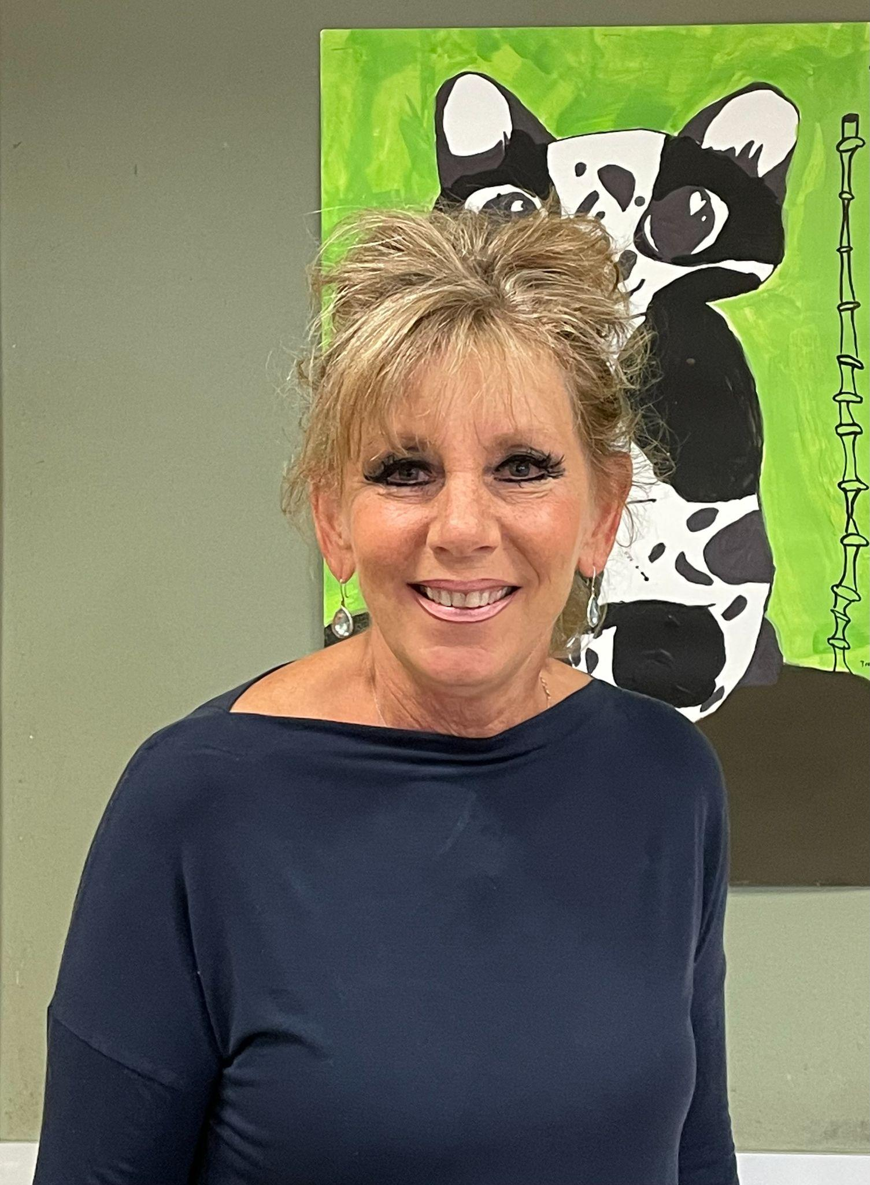
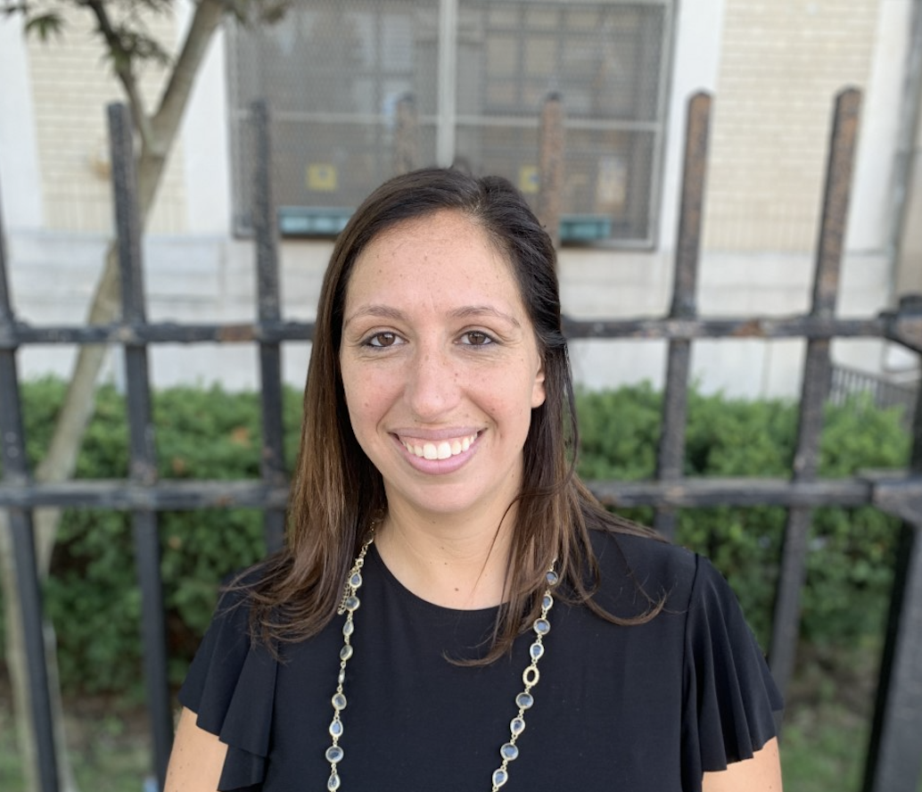
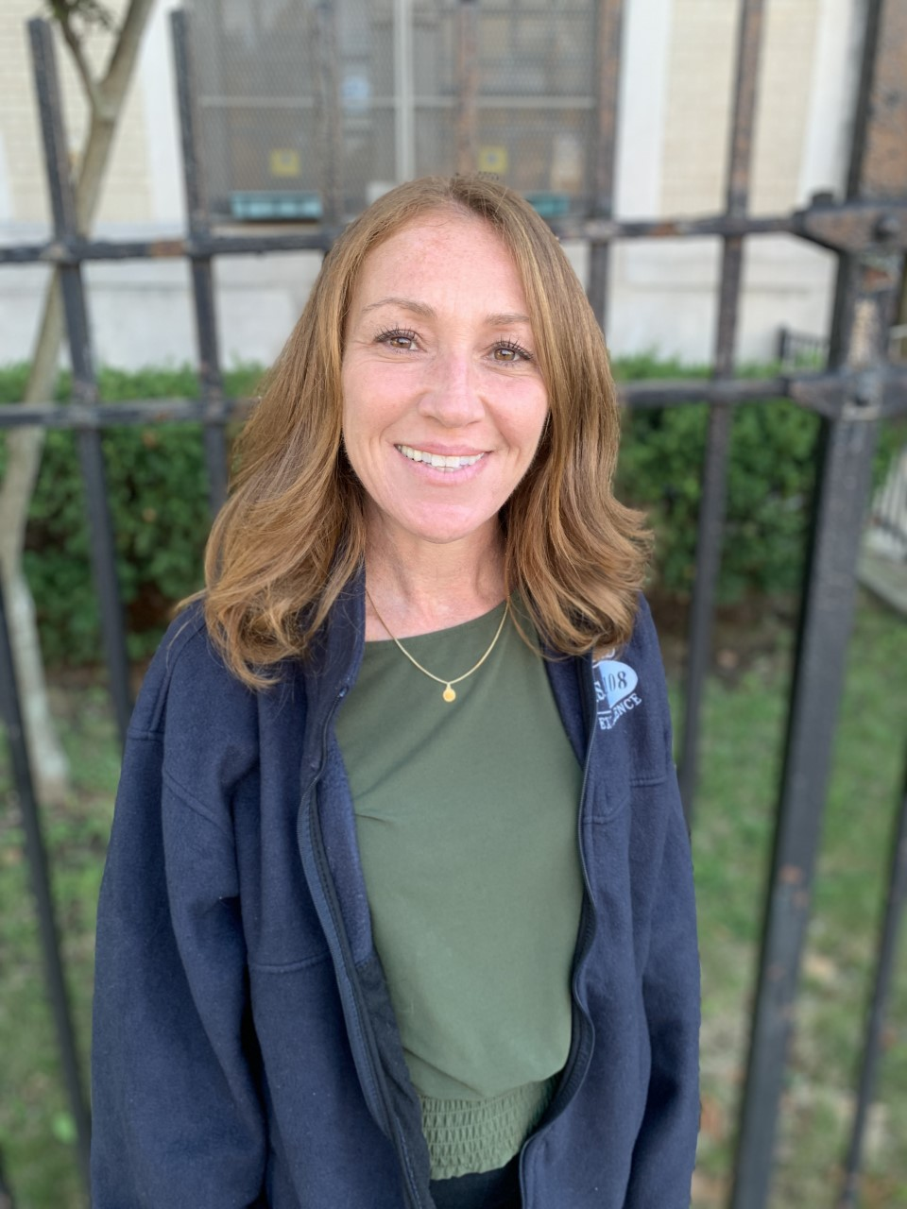
Administration
Lori Solano
Assistant Principal
Lsolano@schools.nyc.gov
Stefania Cedrola-Mustafa
Principal
scedrolamustafa@schools.nyc.gov
Georgette Valente
Assistant Principal
gvalente@schools.nyc.gov

Slide 6

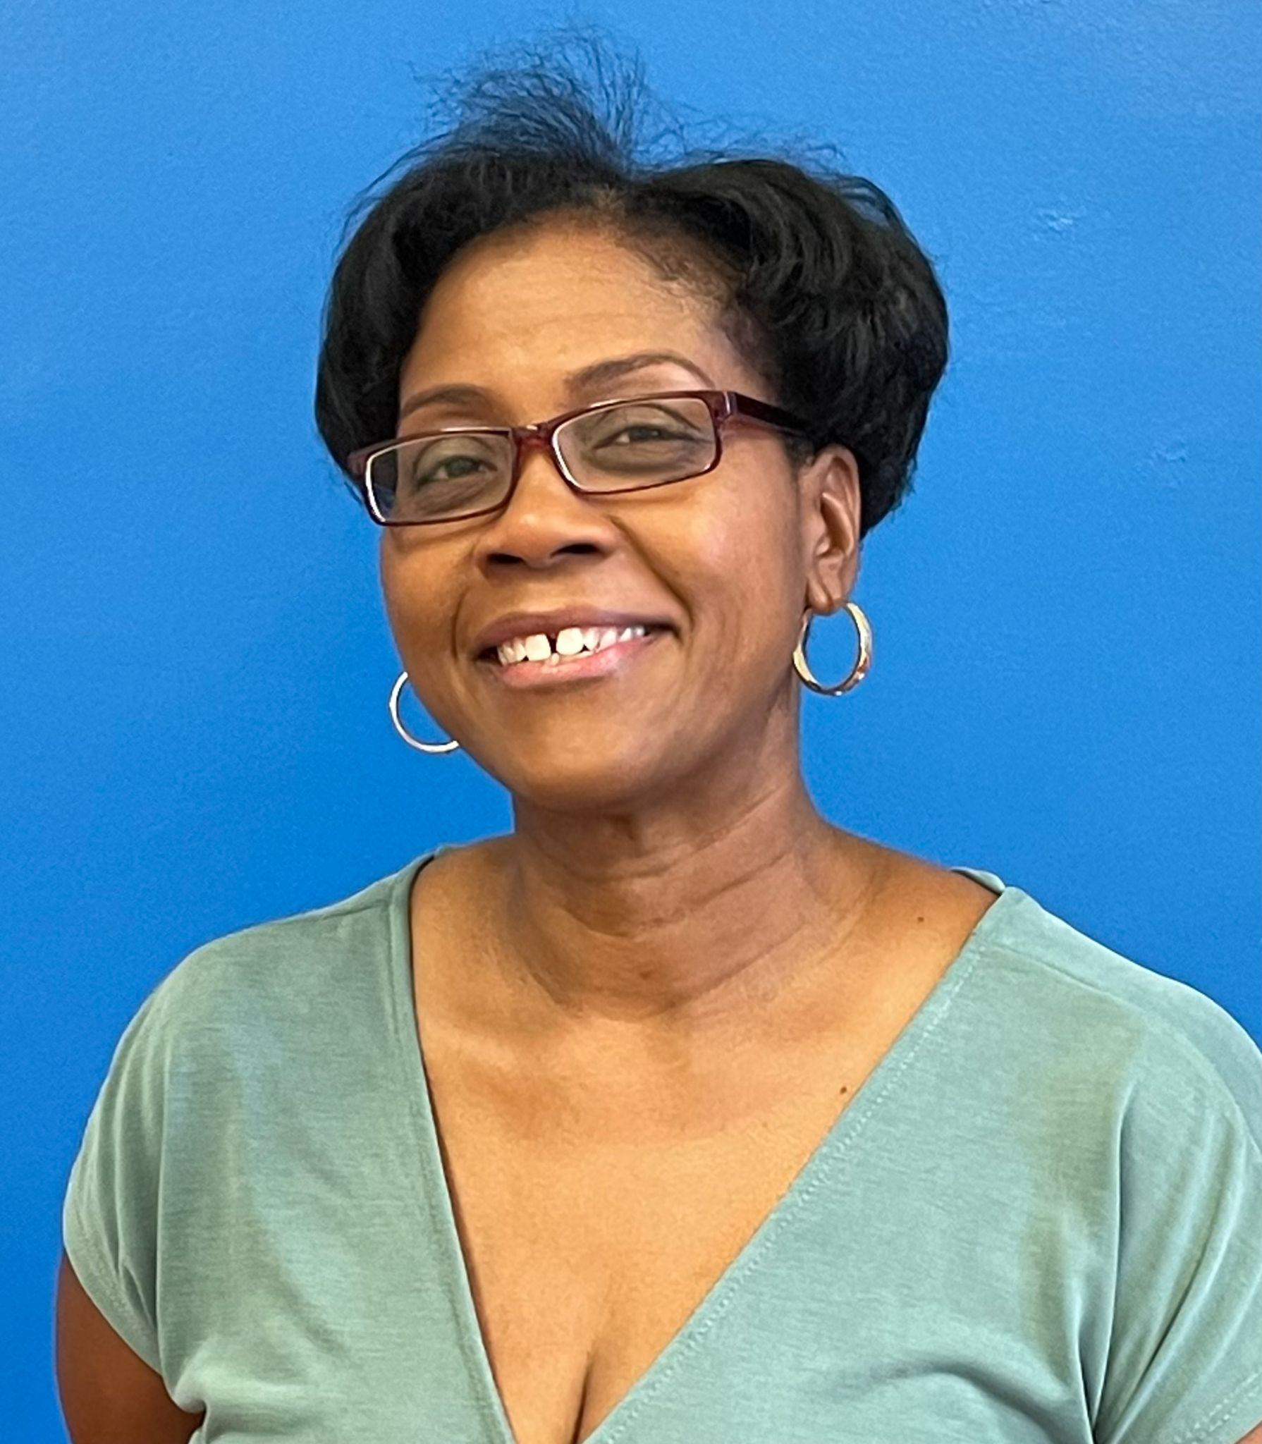
Pre-K
Pre-K Handbook
Ms. Guity
Paraprofessional PK-113
lguity@schools.nyc.gov
Ms. Harper
Teacher PK-113
pharper@schools.nyc.gov

Slide 7
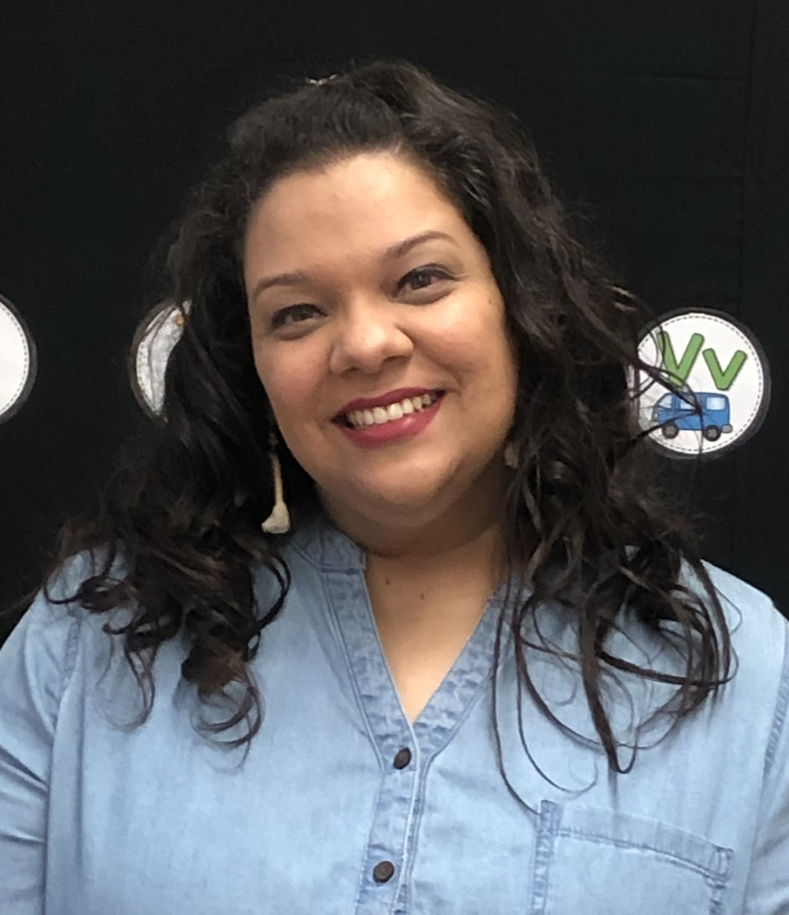
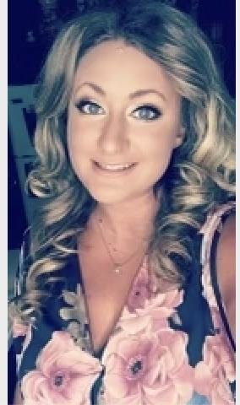
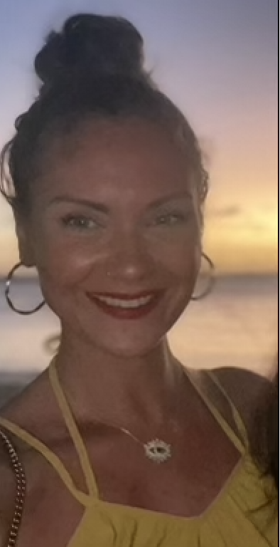
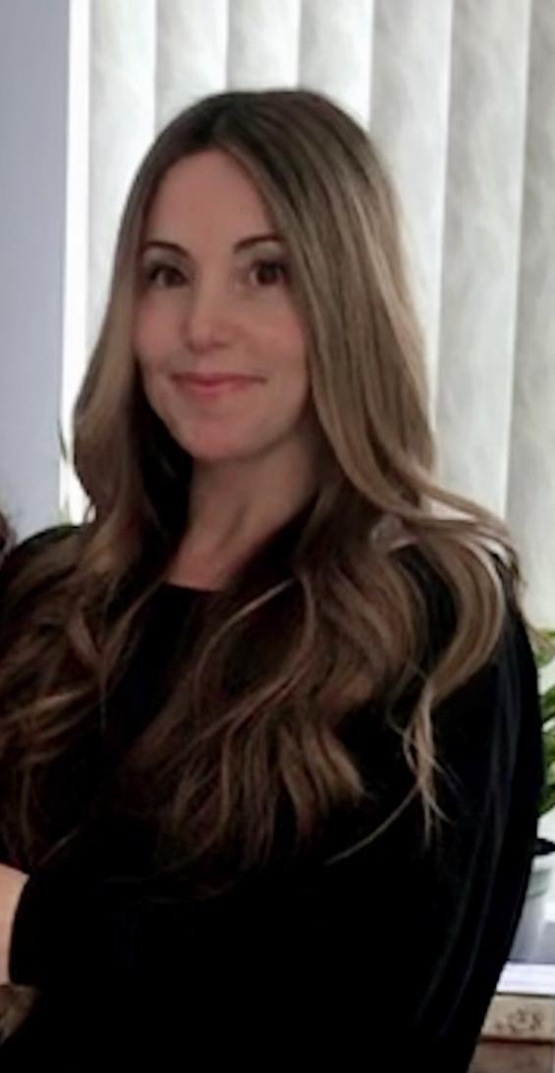
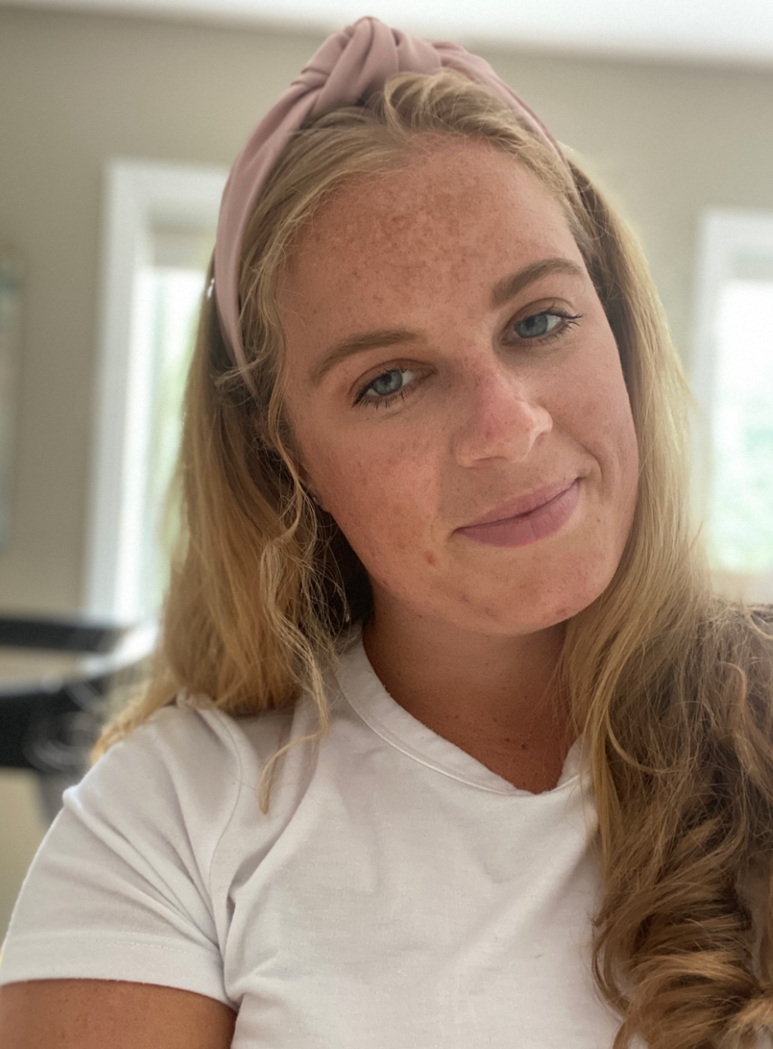
Kindergarten
Ms. Olivo
Teacher K-232
Solivo3@schools.nyc.gov
Ms. Marino
Teacher K-111
jmarino14@schools.nyc.gov
Ms. Nash
Teacher K-213
rnash@schools.nyc.gov
Ms. Bargellini / Ms. Binetti
Teachers K-217
tbargellini@schools.nyc.gov
abinetti3@schools.nyc.gov

Slide 8
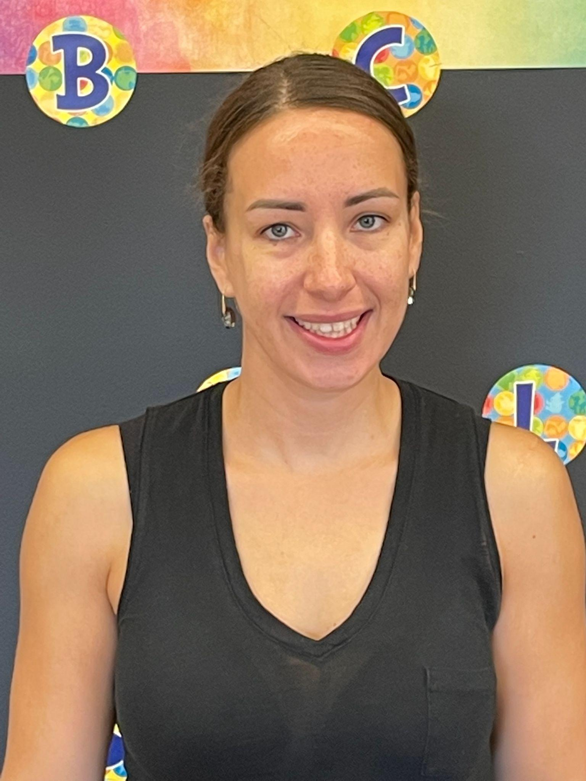
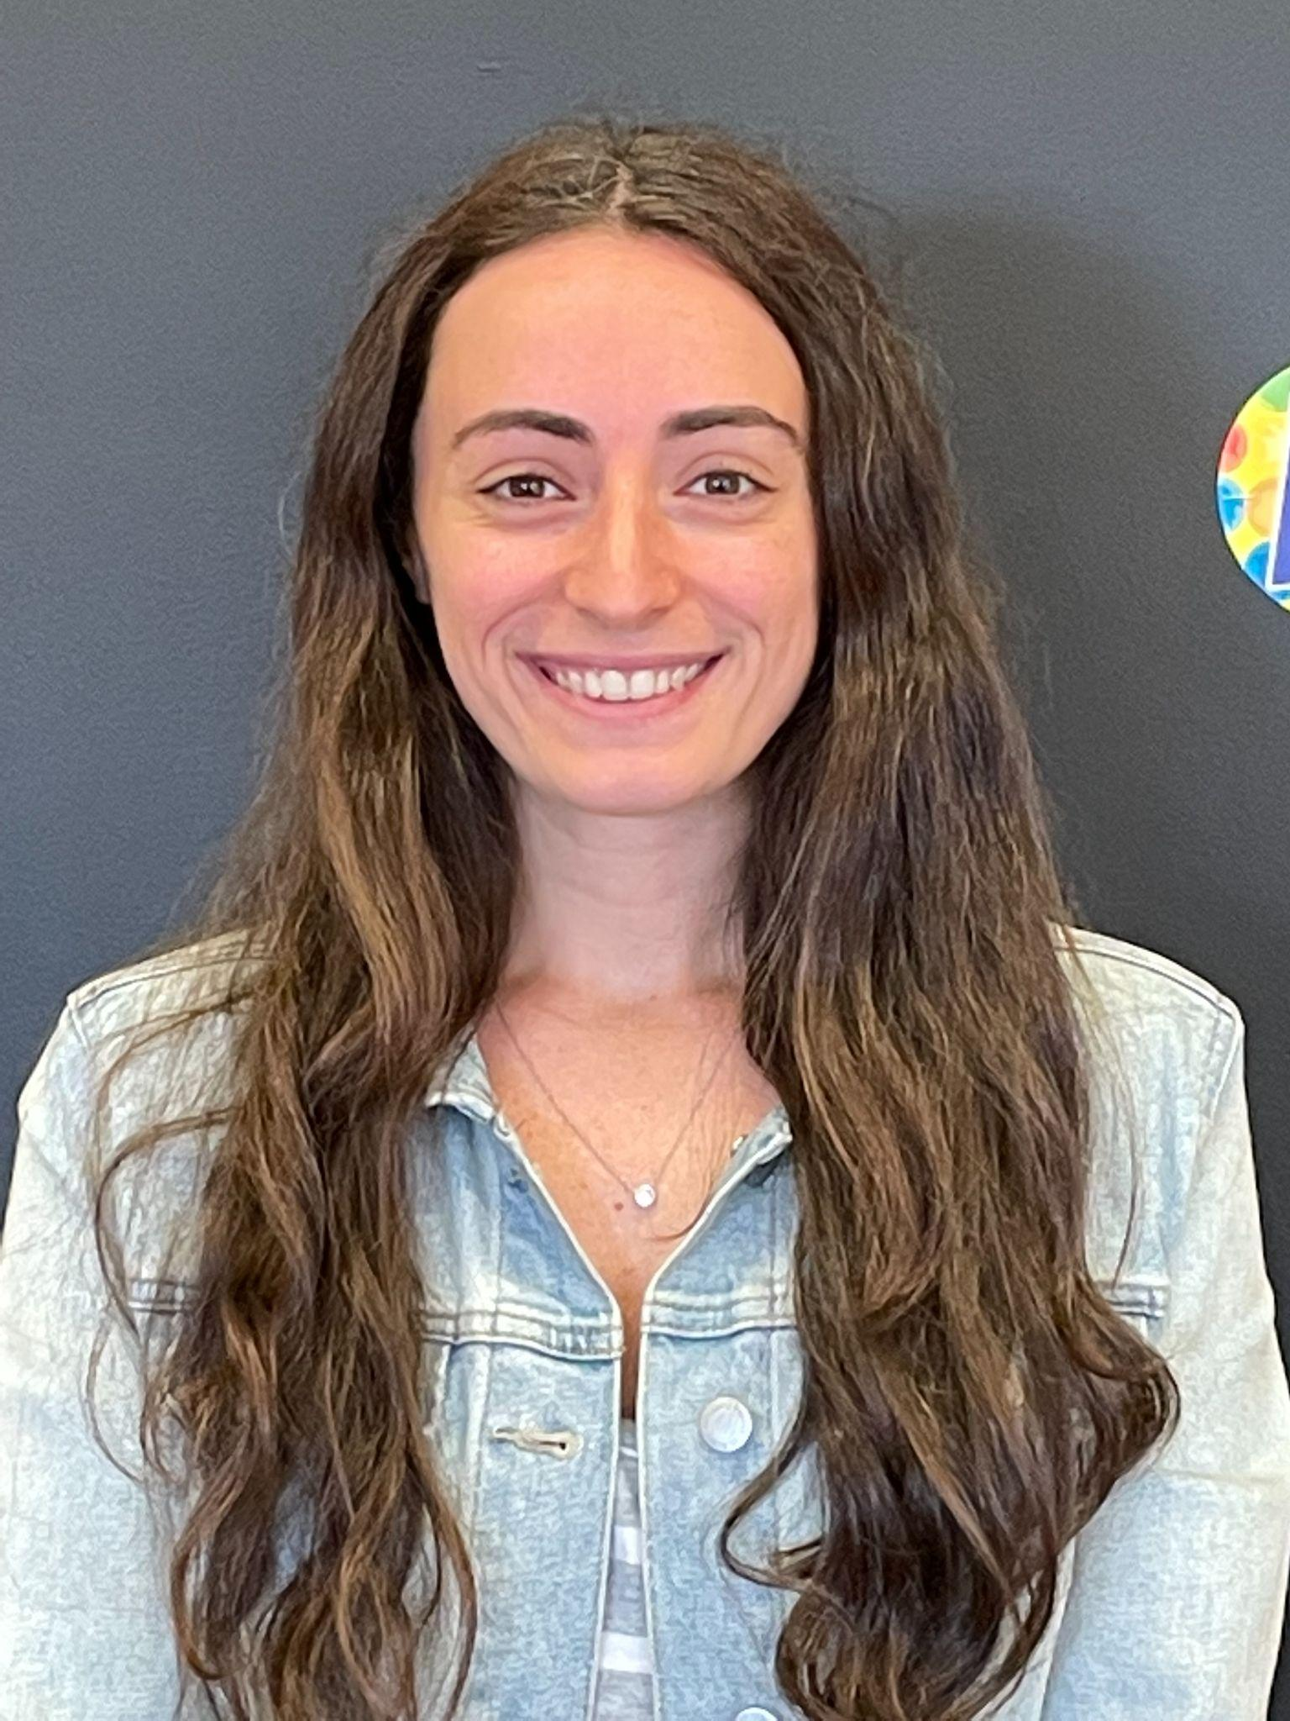
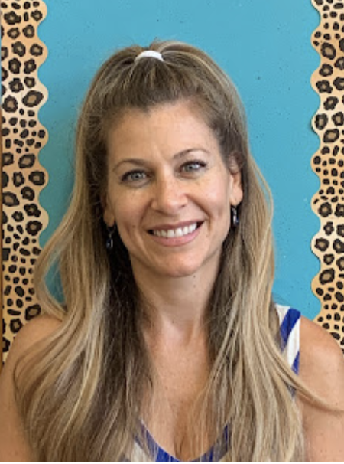
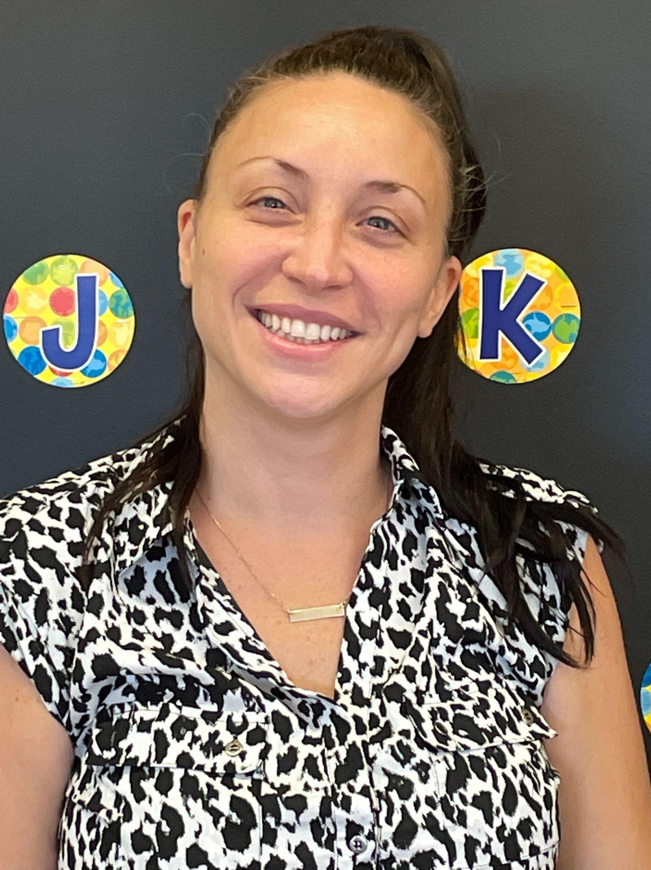
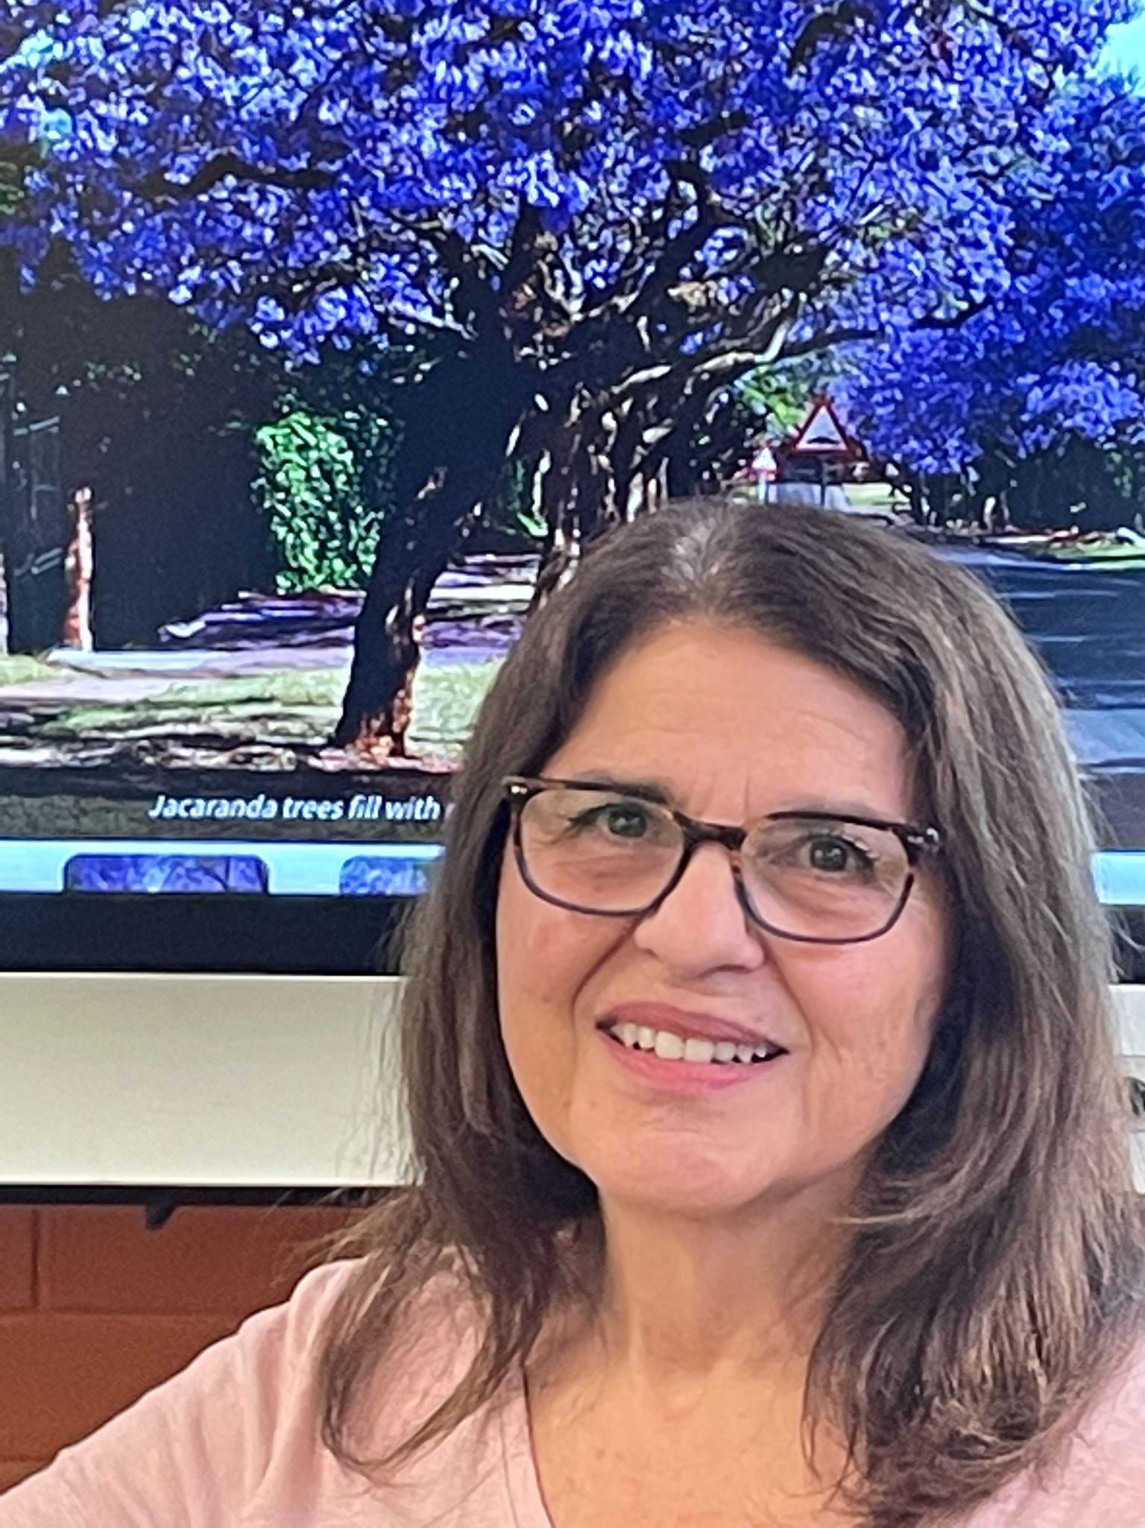
1st Grade
Ms. Carducci
Teacher 1-215
jcarducci@schools.nyc.gov
Ms. Anselme / Ms. Spergel
Teachers 1-327
aanselme@schools.nyc.gov
kspergel@schools.nyc.gov
Ms. Mancini
Teacher 1-223
RMancini@schools.nyc.gov
Ms. Goldstein
Teacher K/1/2 -127
fgoldstein@schools.nyc.gov

Slide 9
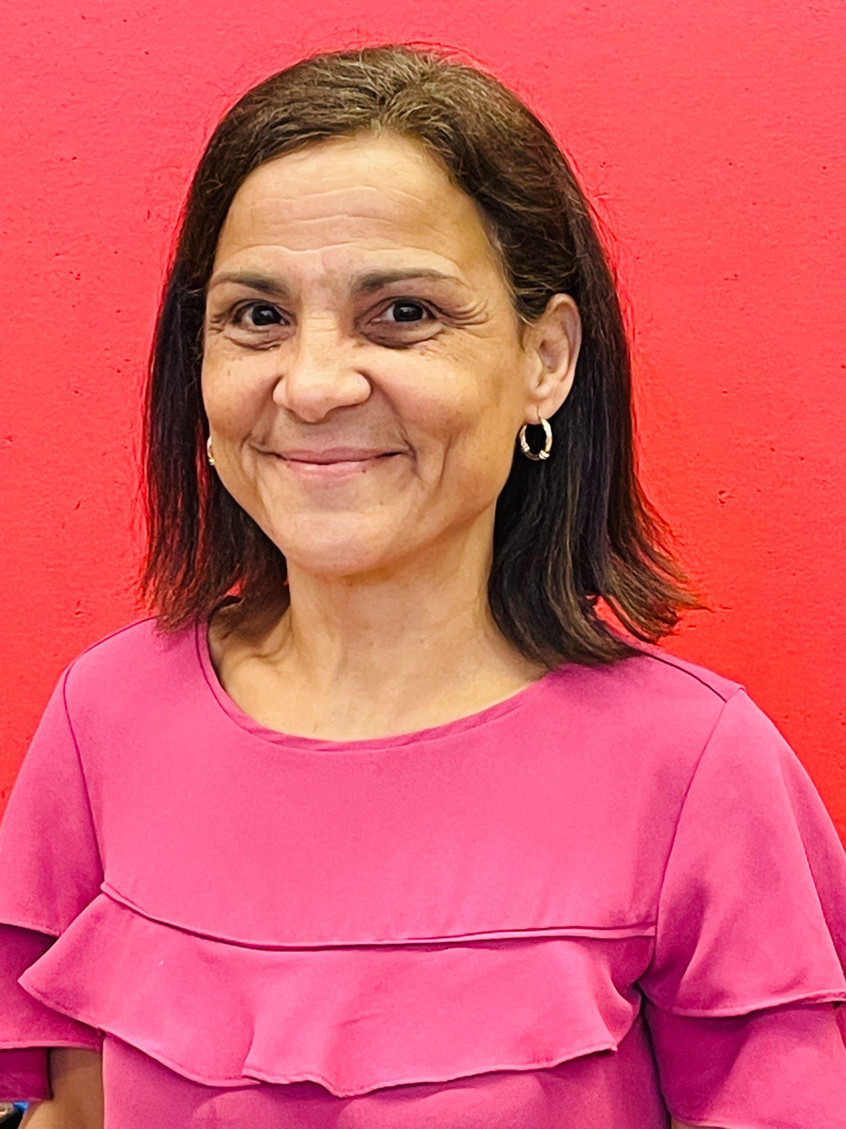
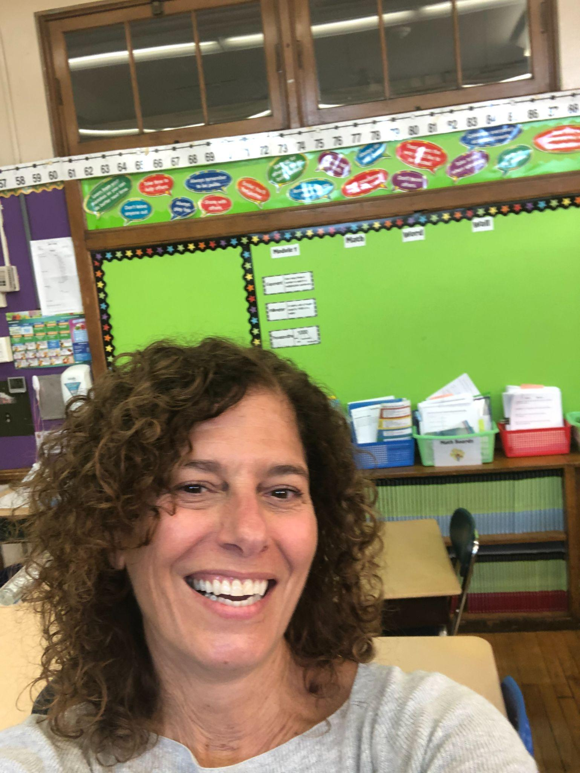
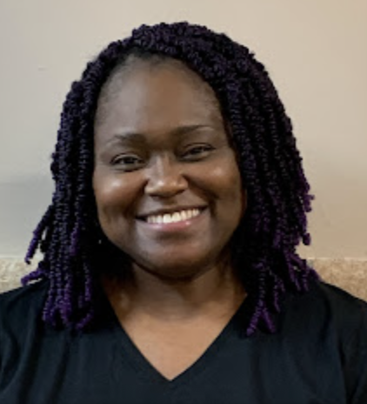
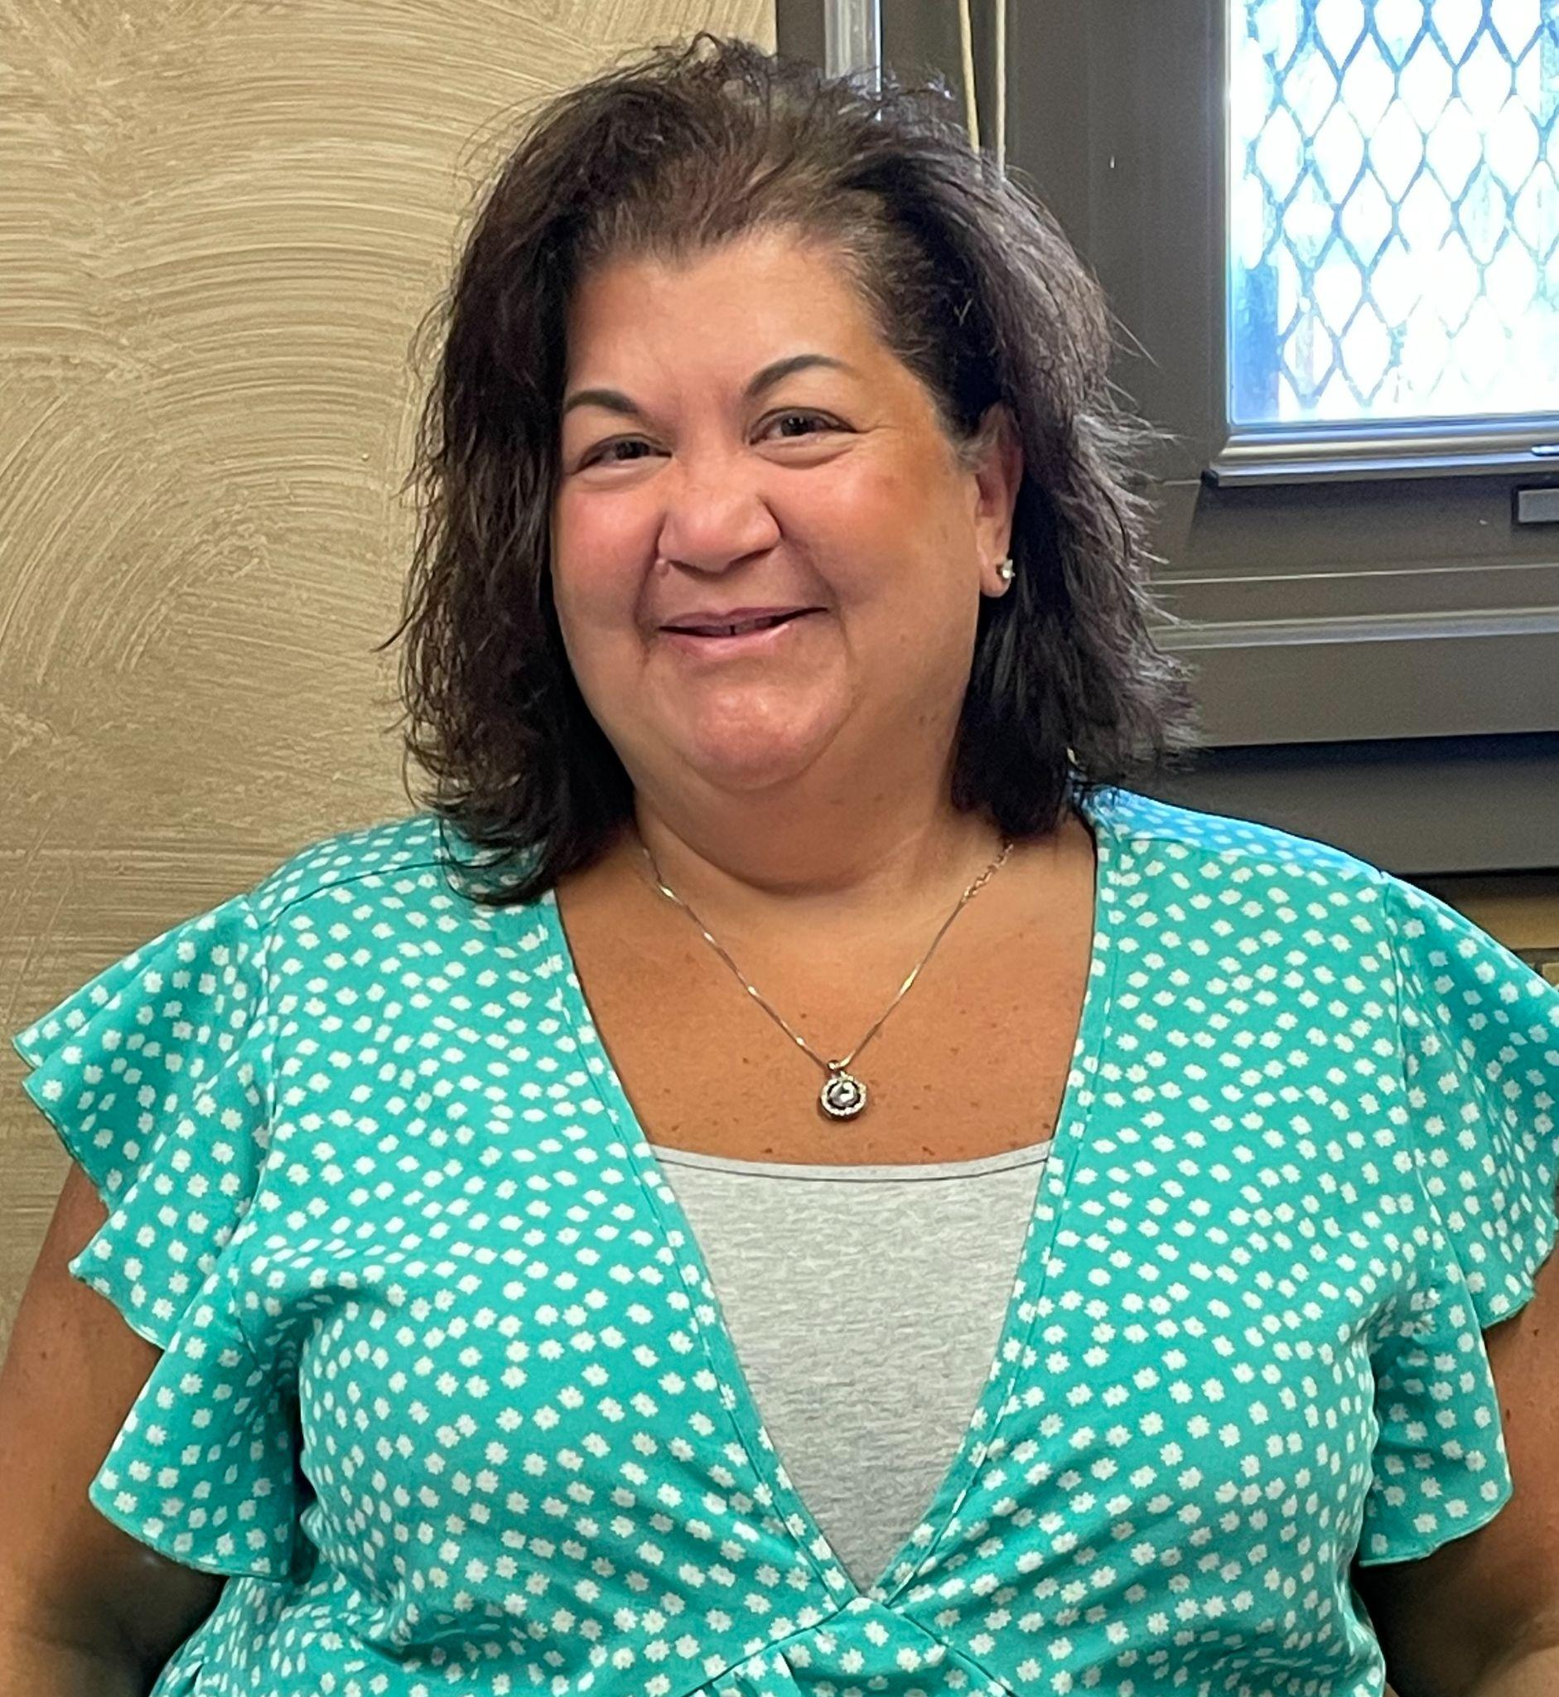
2nd Grade
Ms. Hefter
Teacher 2-221
Dhefter@schools.nyc.gov
Ms. Puff / Ms. Paparelli
Teachers 2-309
MPuff2@schools.nyc.gov
jpaparelli@schools.nyc.gov
Ms. Roksvold
Teacher 2-317
troksvold@schools.nyc.gov

Slide 10
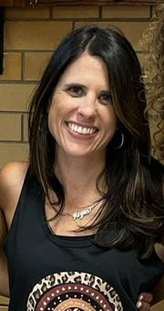
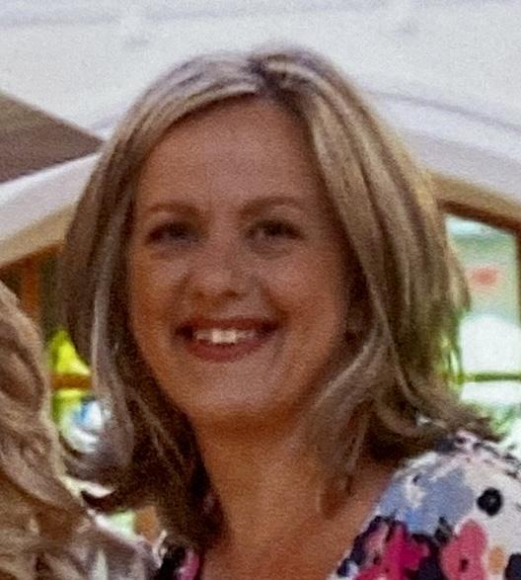
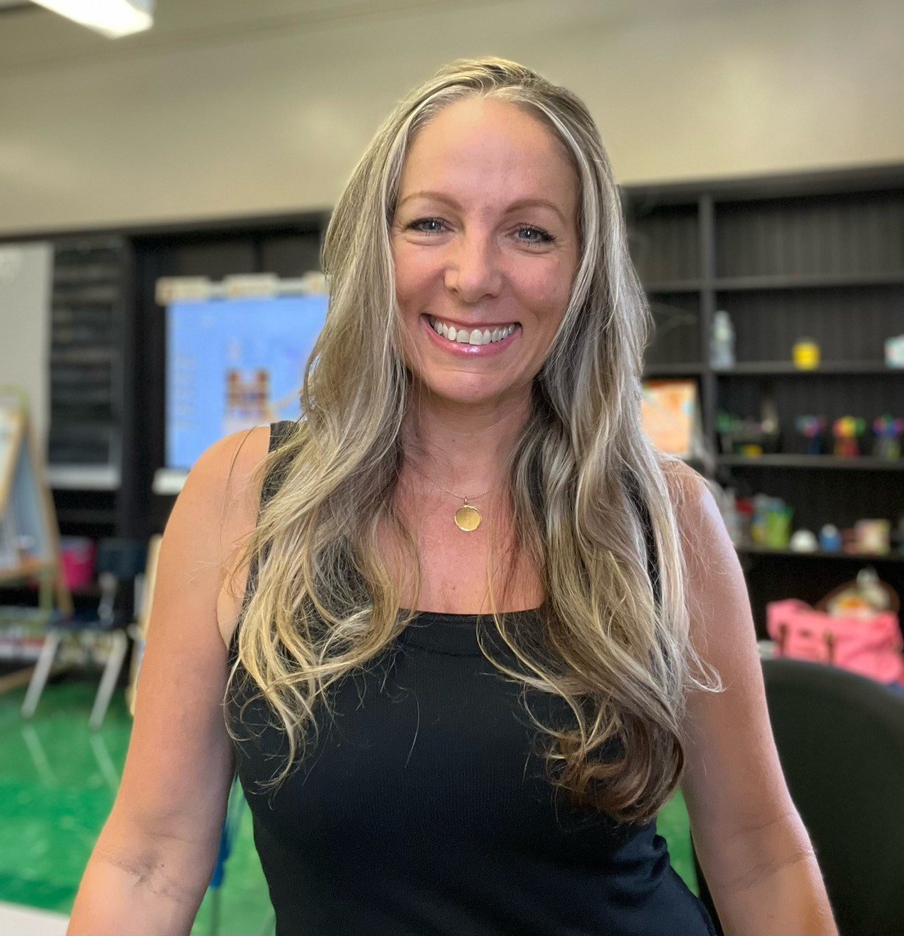
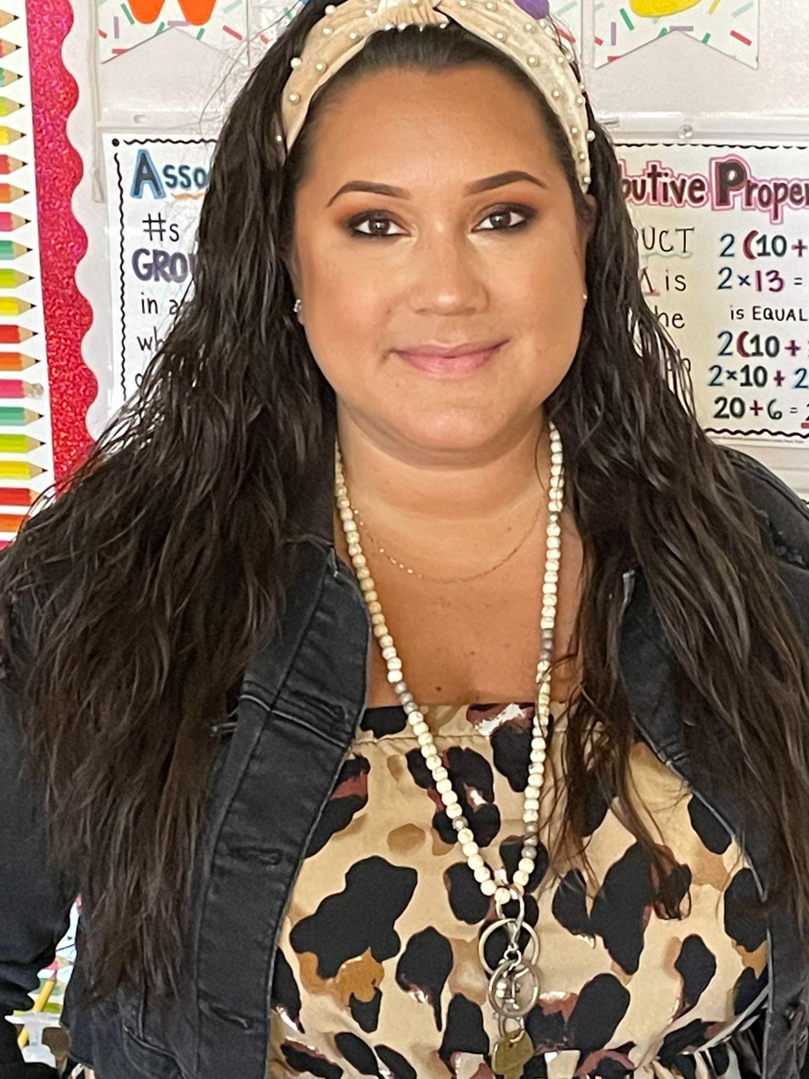
3rd Grade
Ms. Ulrich
Teacher 3-313
aulrich@schools.nyc.gov
Ms. Polgano / Ms. Lanza
Teachers 3-315
jpolgano@schools.nyc.gov
Mboyle8@schools.nyc.gov
Ms. Lent
Teacher 3-321
jlent2@schools.nyc.gov

Slide 11
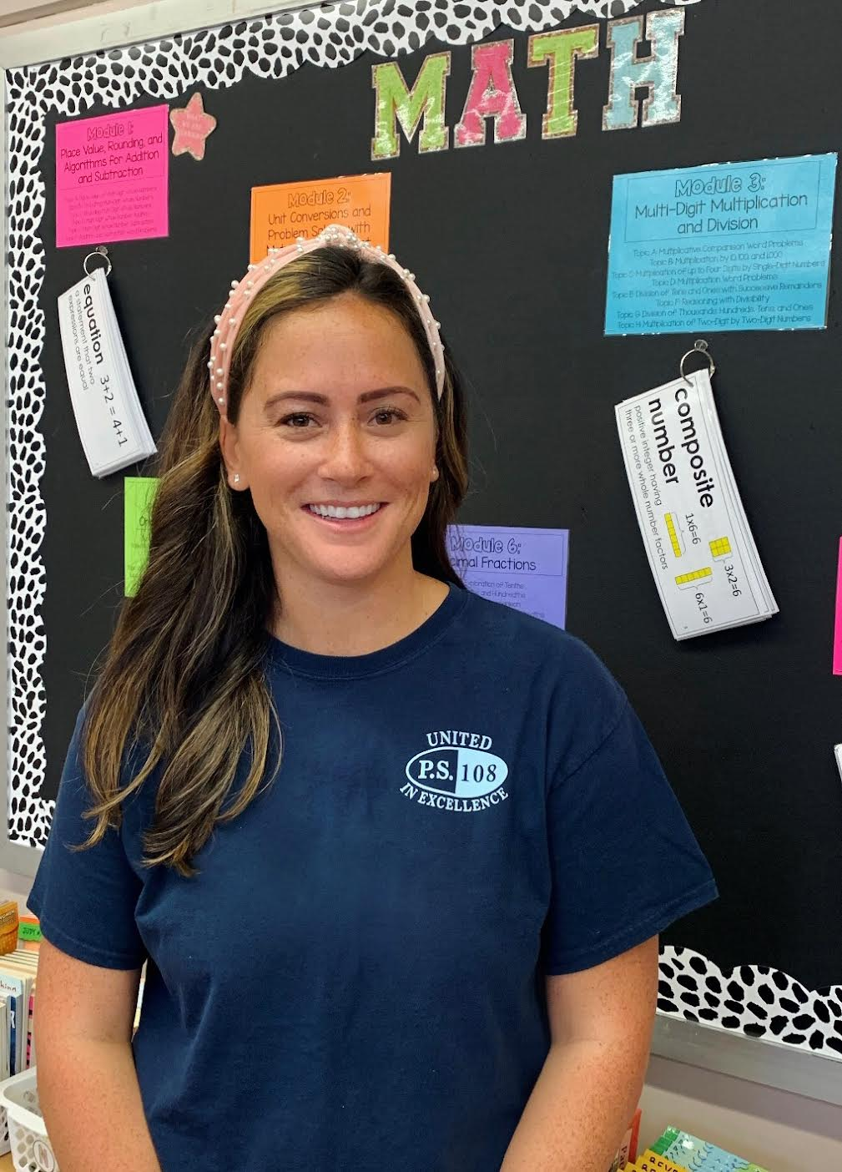
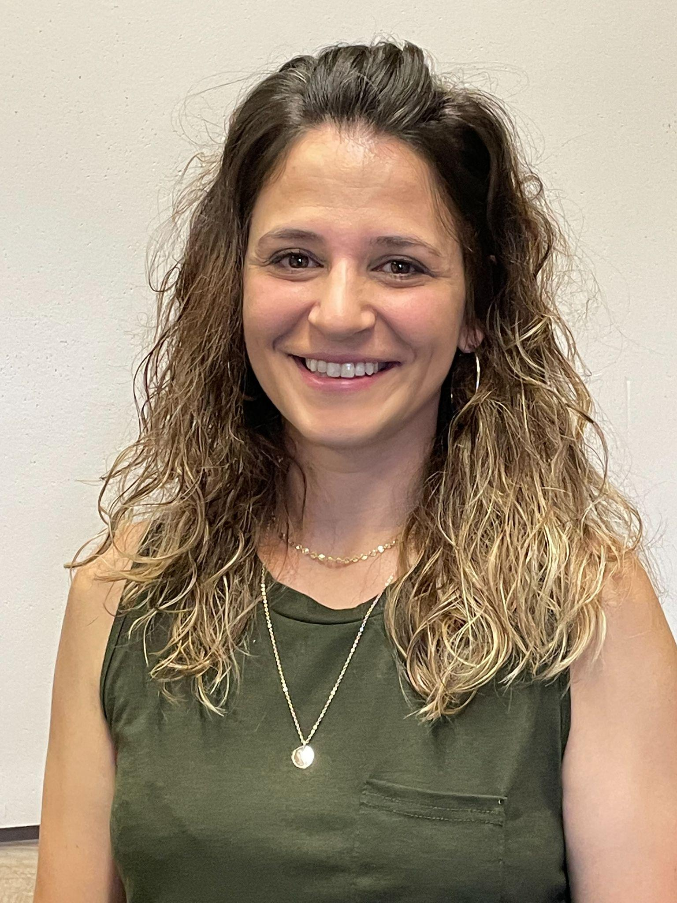
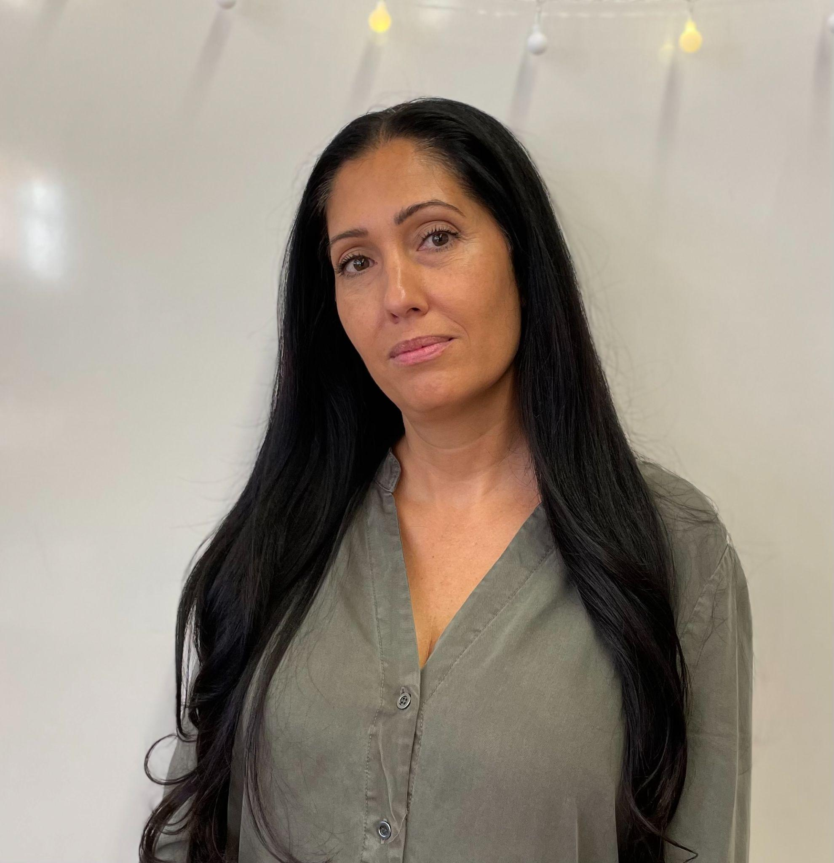
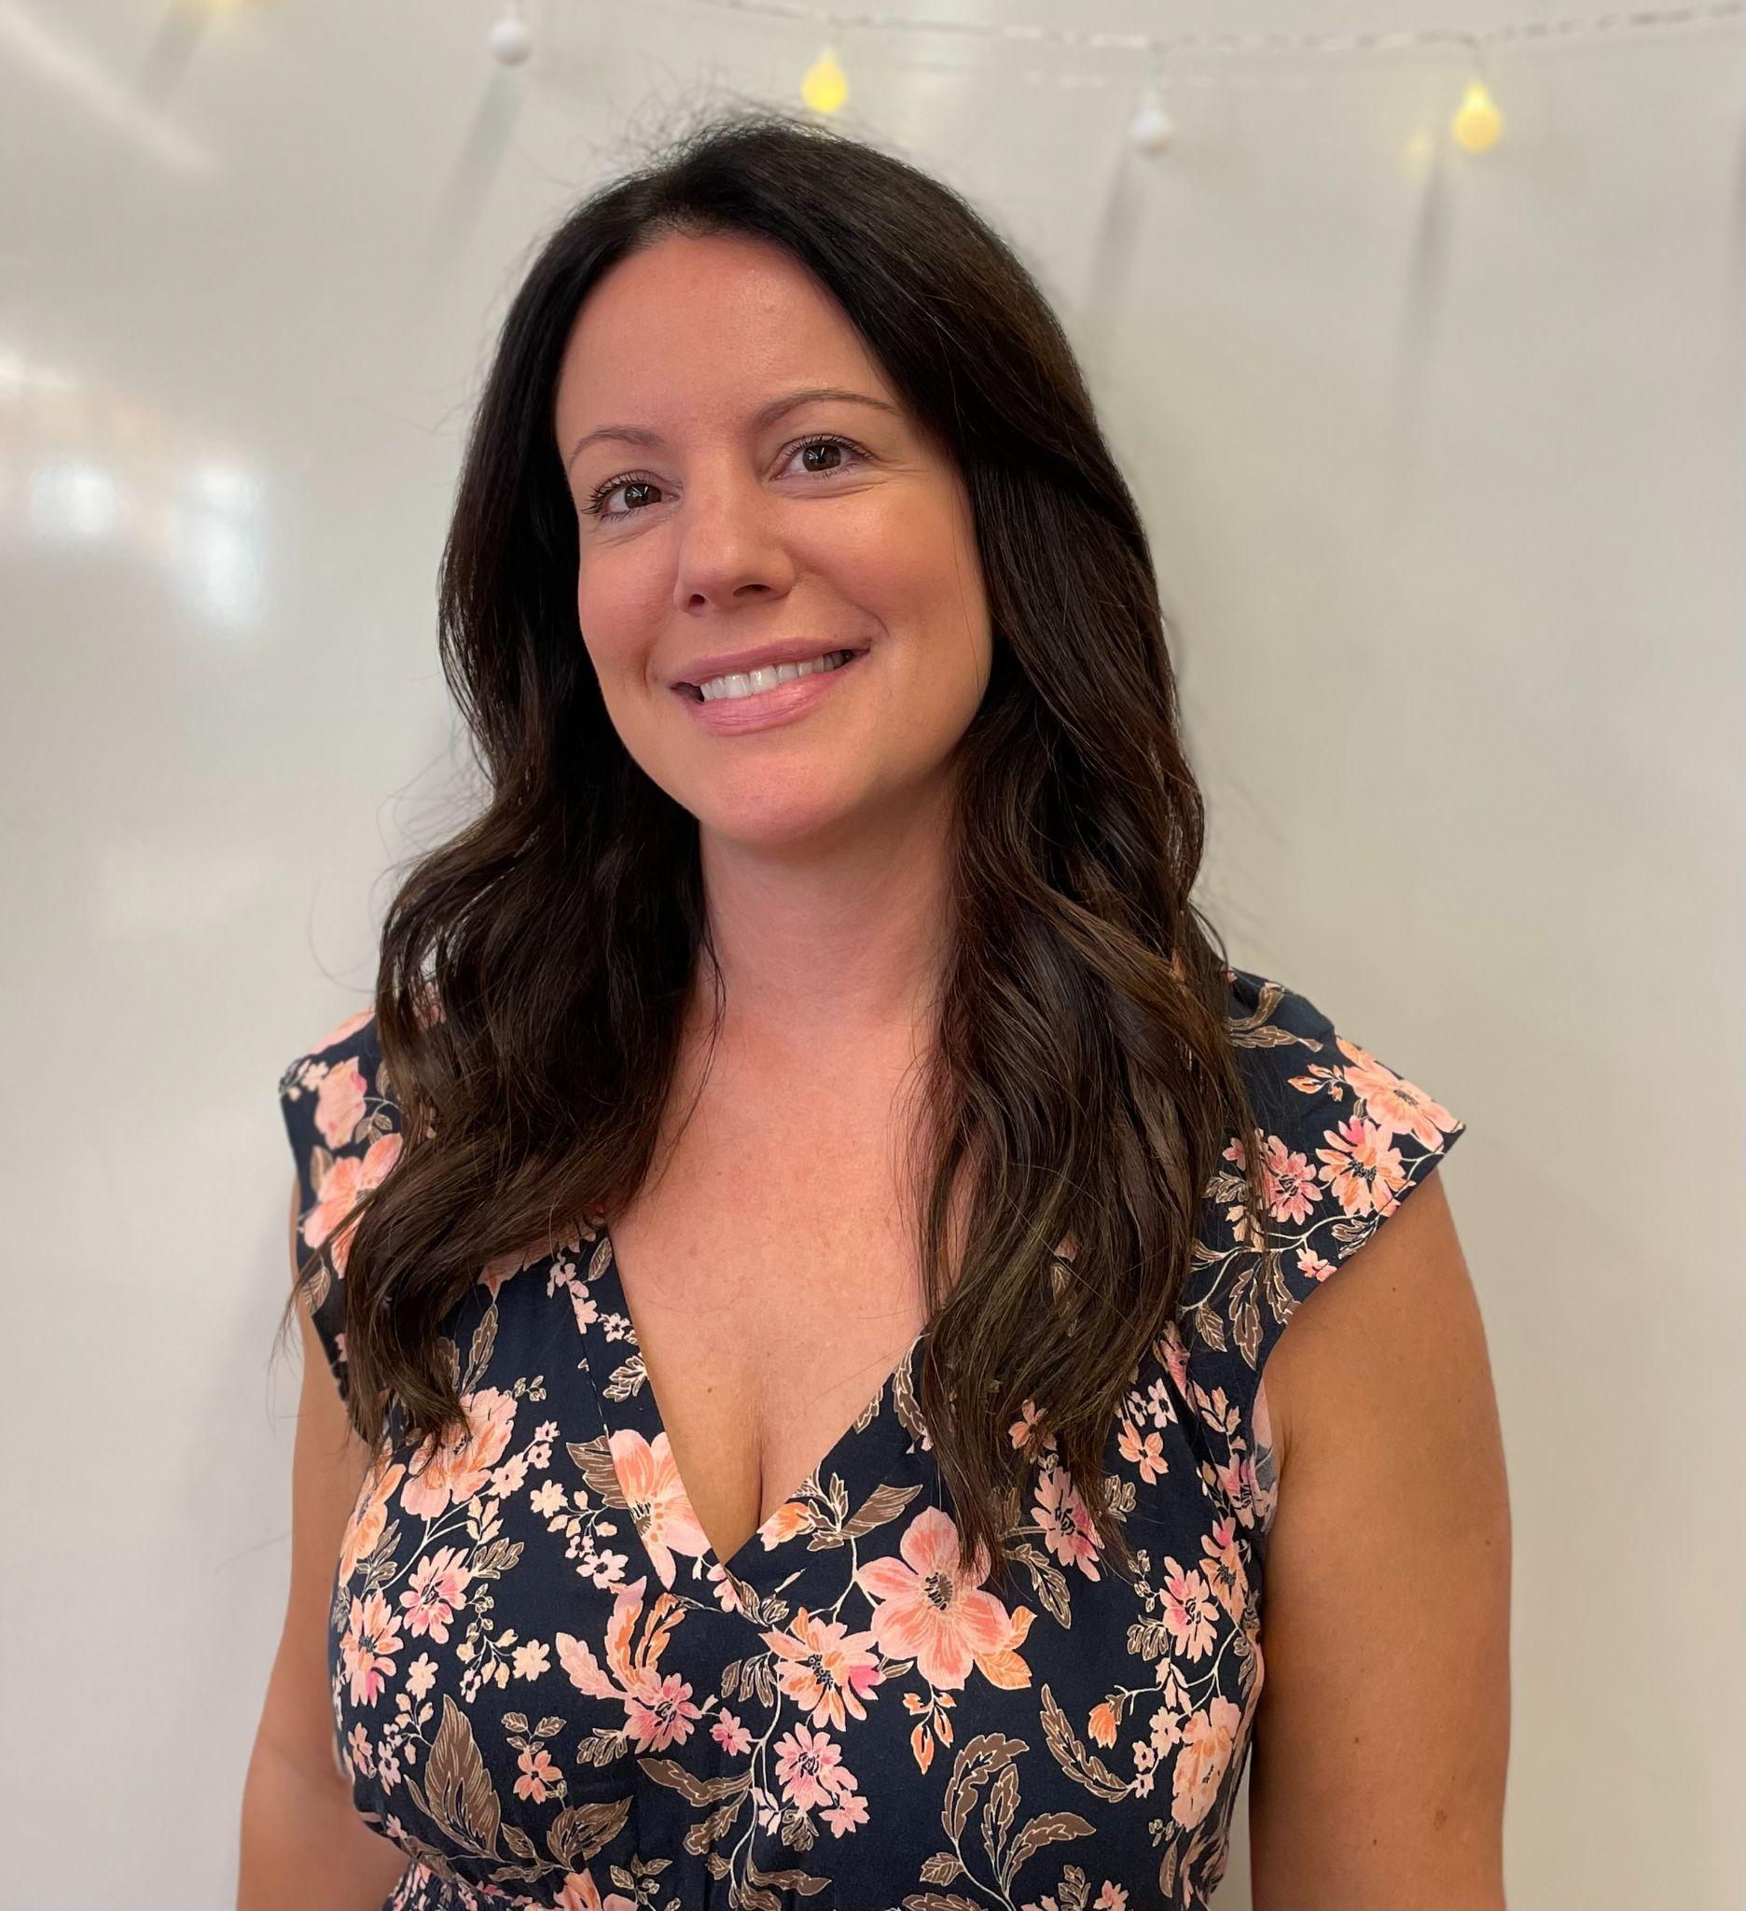
4th Grade
Ms. Forrest
Teacher 4-225
pforrest2@schools.nyc.gov
Ms. Breitenbach
Teacher 4-323
dbreitenbach@schools.nyc.gov
Ms. Keeney / Ms. Ujkashi
Teachers 4-325
Ckeeney2@schools.nyc.gov
stagani@schools.nyc.gov

Slide 12
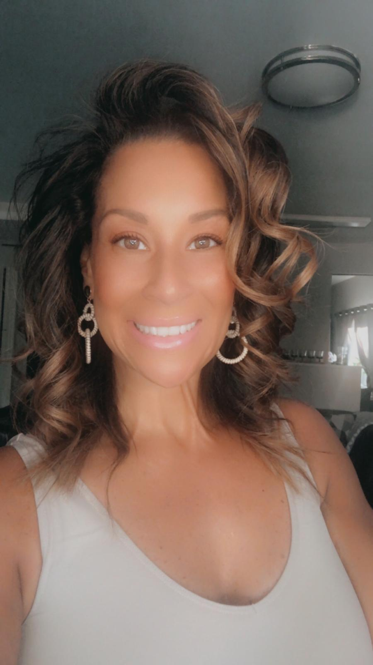
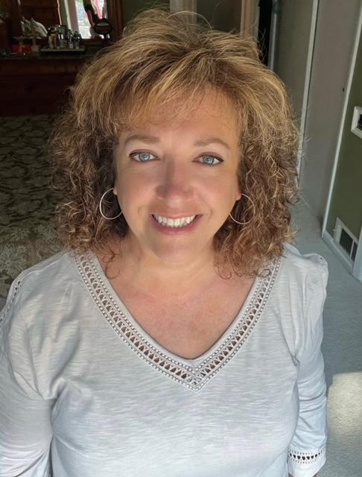
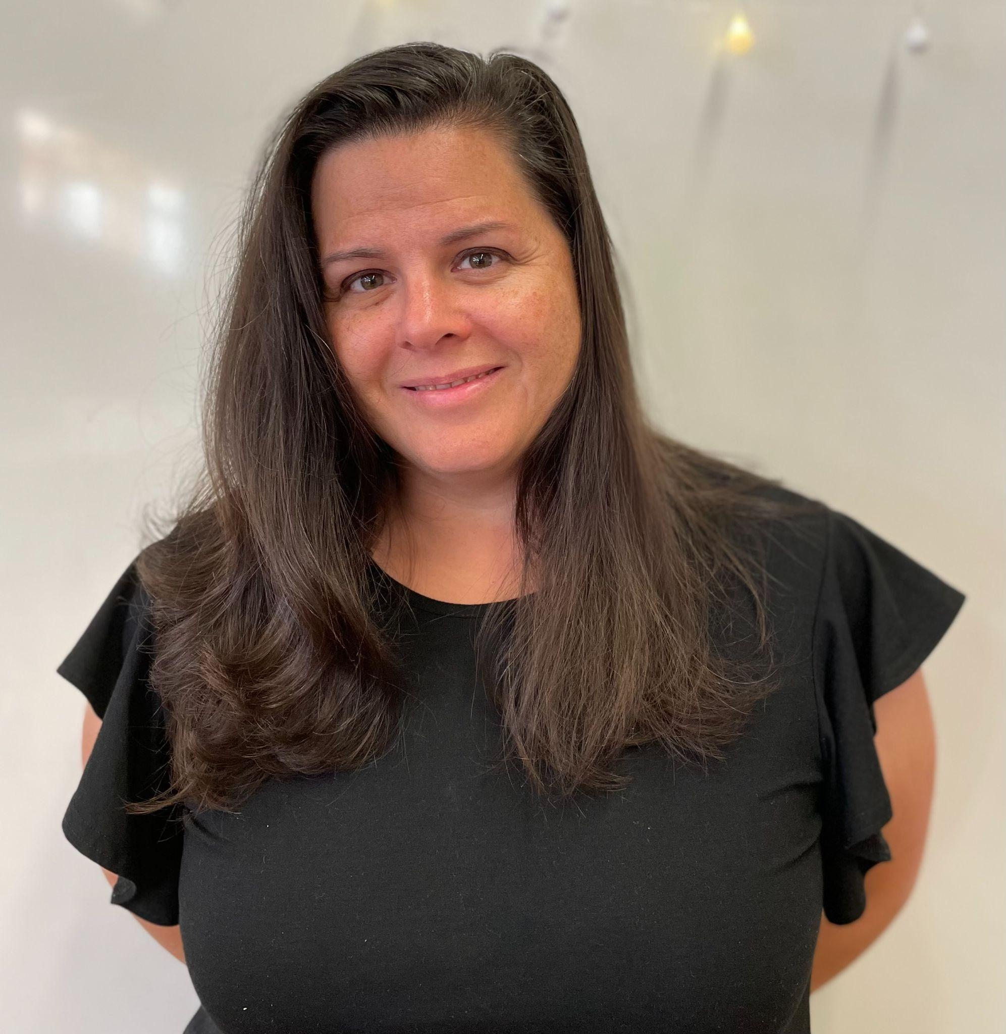
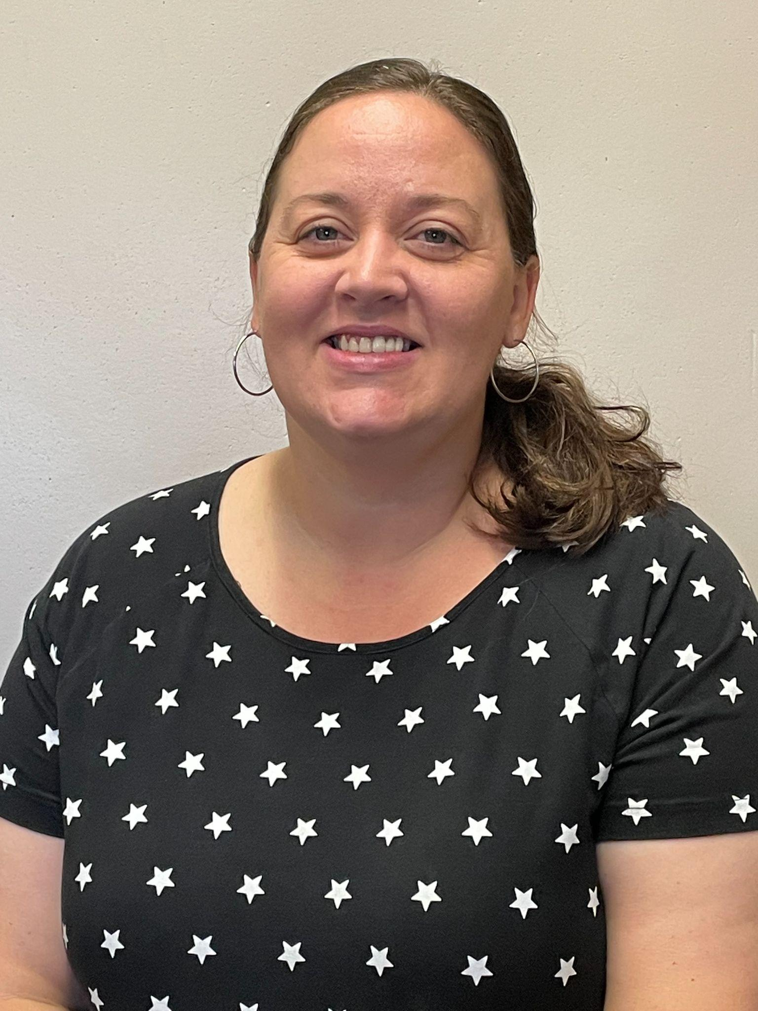
5th Grade
Ms. Calderin
Teacher 5-332
Vserran@schools.nyc.gov
Ms. Bennett
Teachers 5-329
lbennett5@schools.nyc.gov
Ms. Tirelli / Ms. Cerbone
Teacher 5-229
KTirell@schools.nyc.gov
kcerbone@schools.nyc.gov

Slide 13
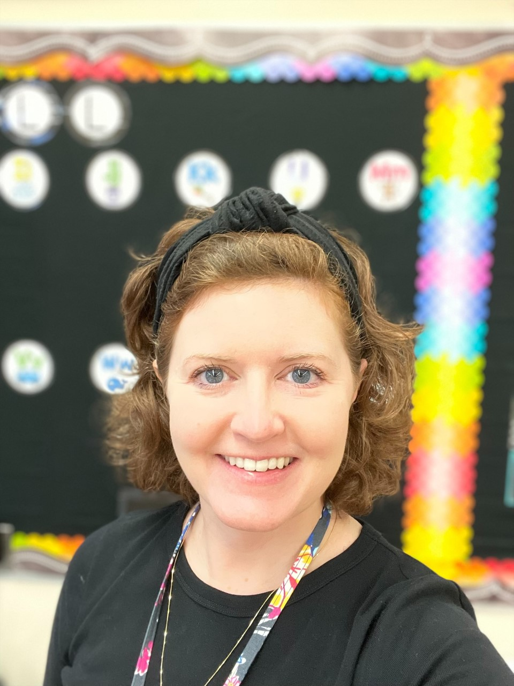
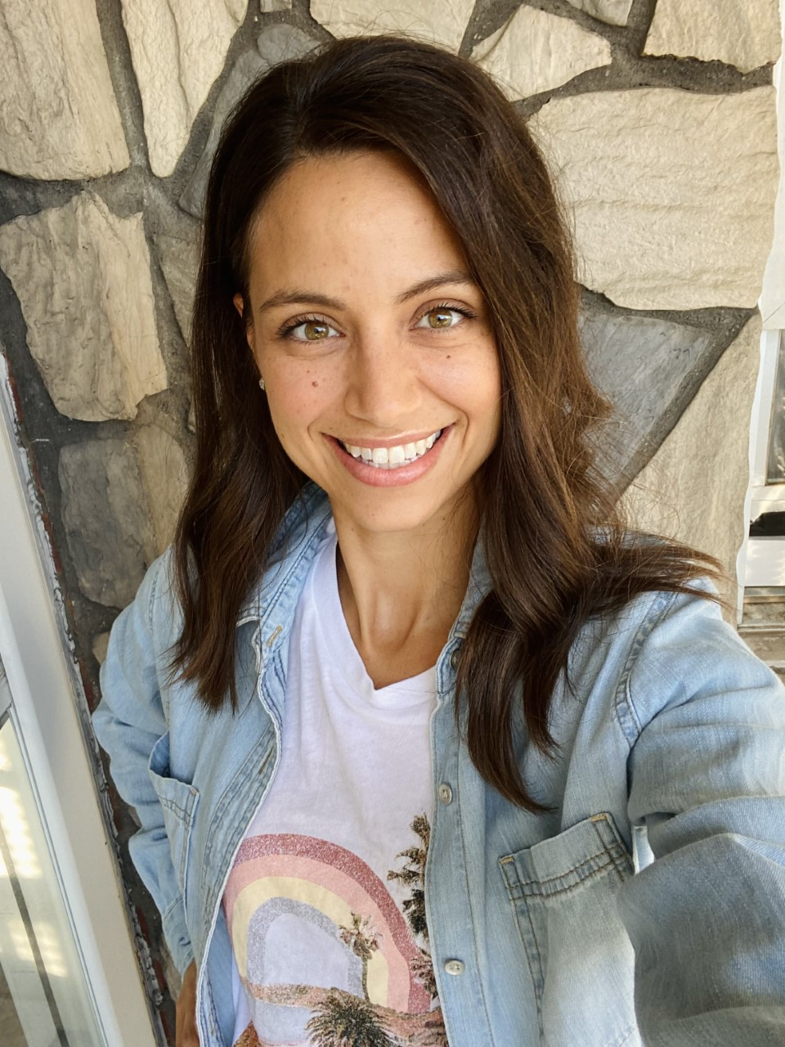
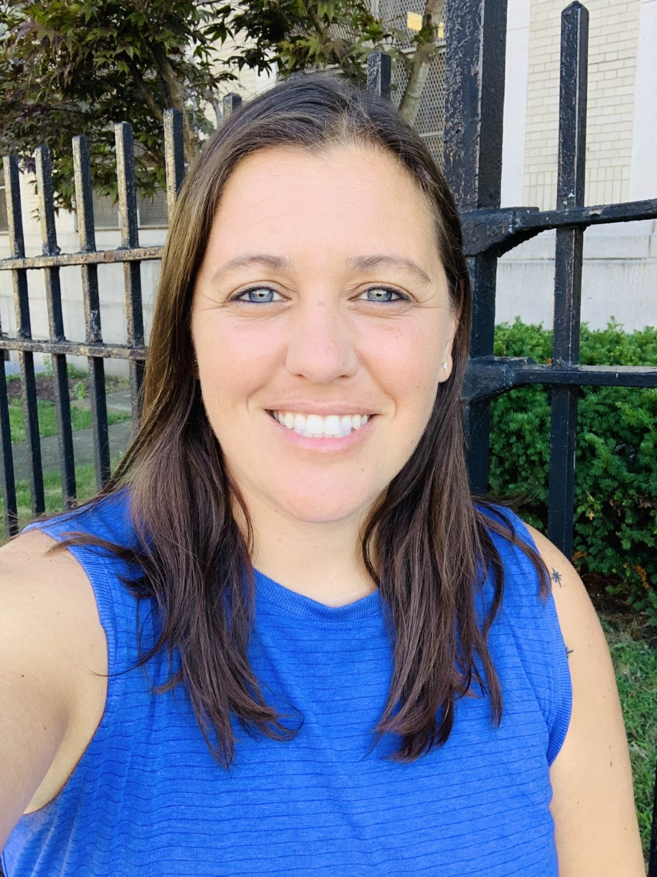
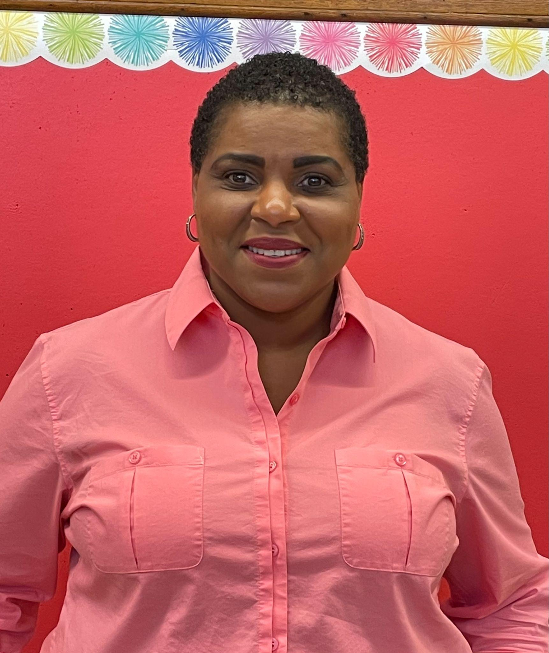
Cluster Teachers
Ms. Donnarummo
Music
edonnarummo@schools.nyc.gov
Ms. Amore
Art
samore@schools.nyc.gov
Dr. Thompson
Science
VThompsonCudjoe@schools.nyc.gov
Ms. Macagnone
Physical Education
Smacagnone@schools.nyc.gov

Slide 14
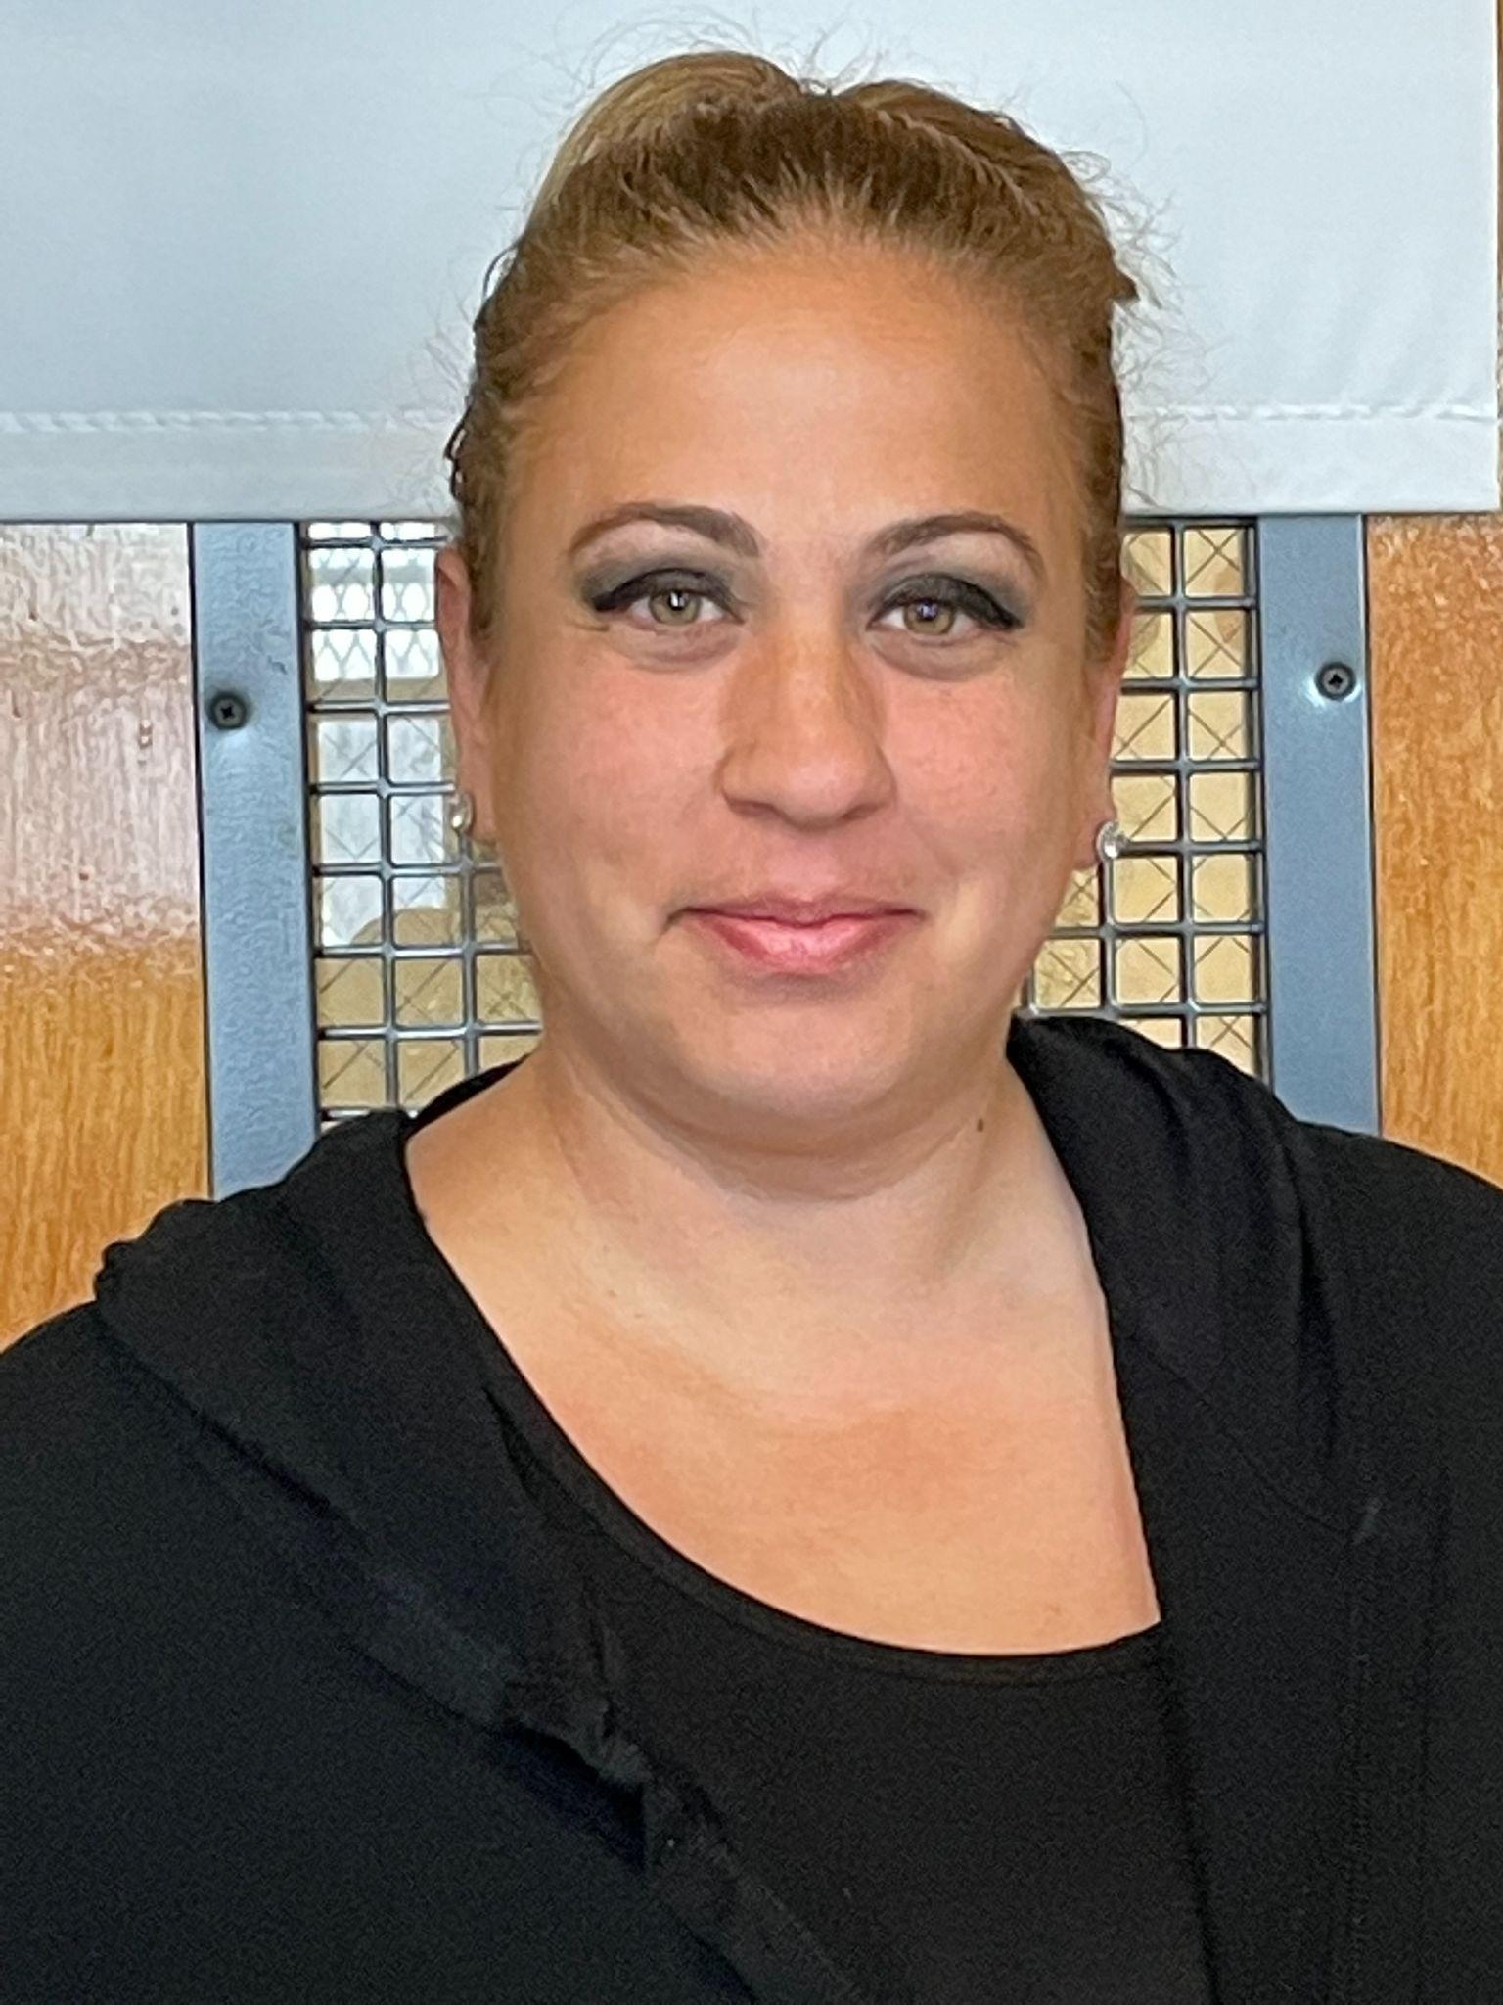
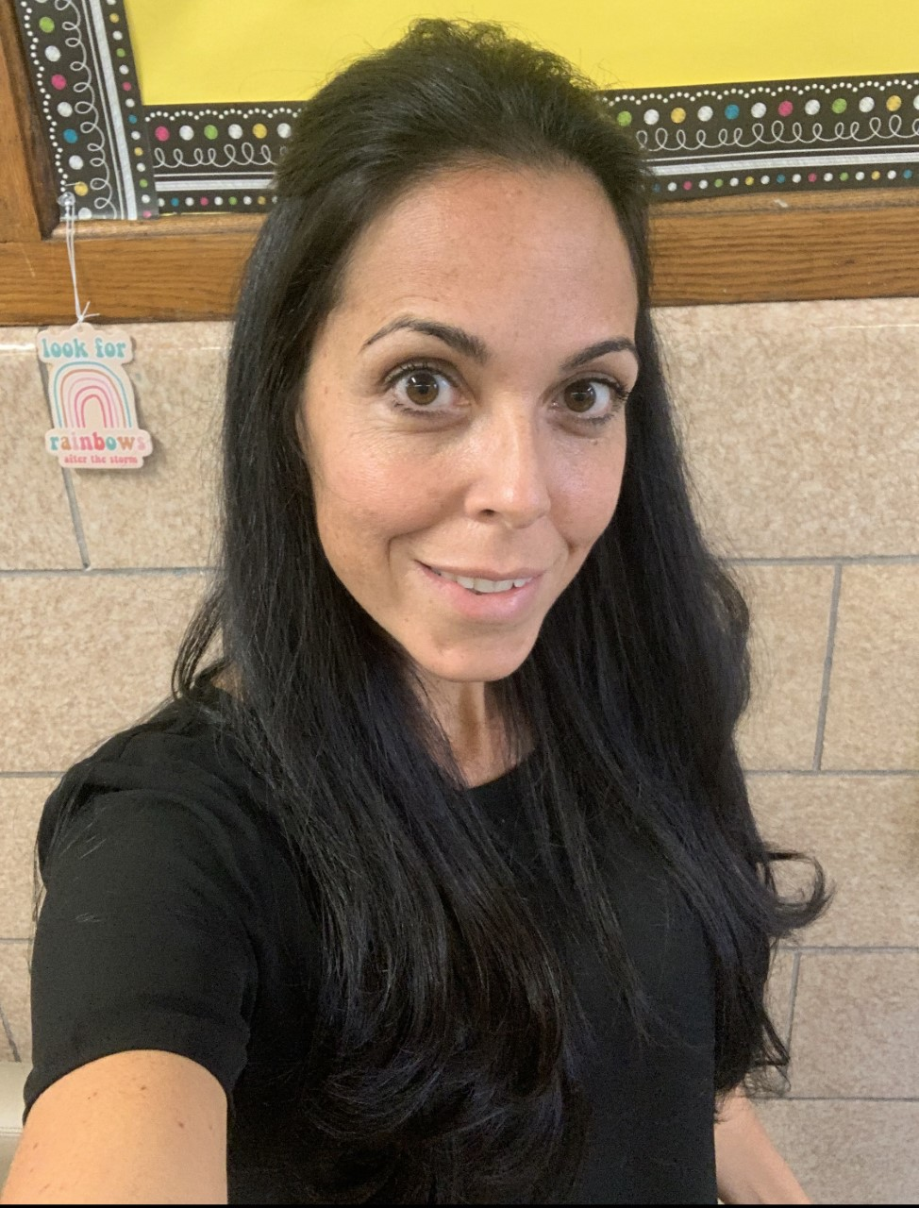
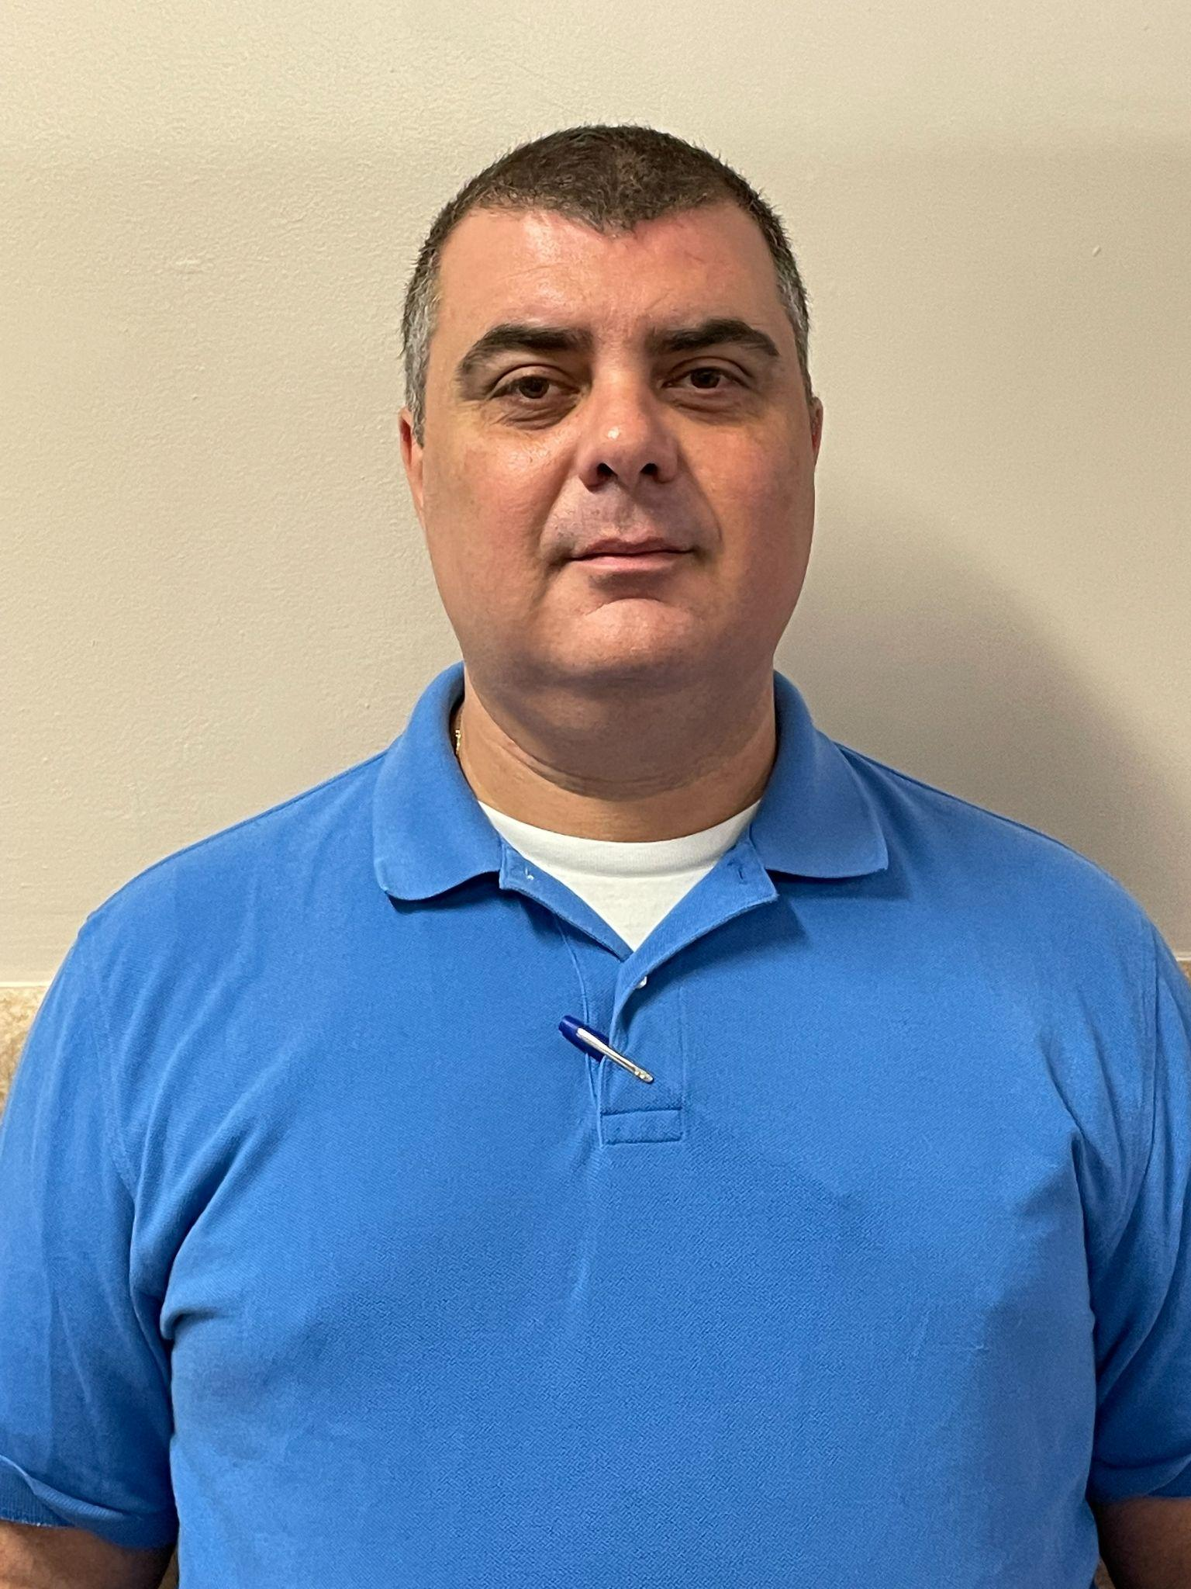
Support Staff
Ms. LoCascio
SETSS / RTI Teacher
rlocascio@schools.nyc.gov
Ms. Simonetti
SETSS / IEP Teacher
Msimonetti2@schools.nyc.gov
Mr. Dushaj
Technology Coordinator
pdushaj2@schools.nyc.gov

Slide 15
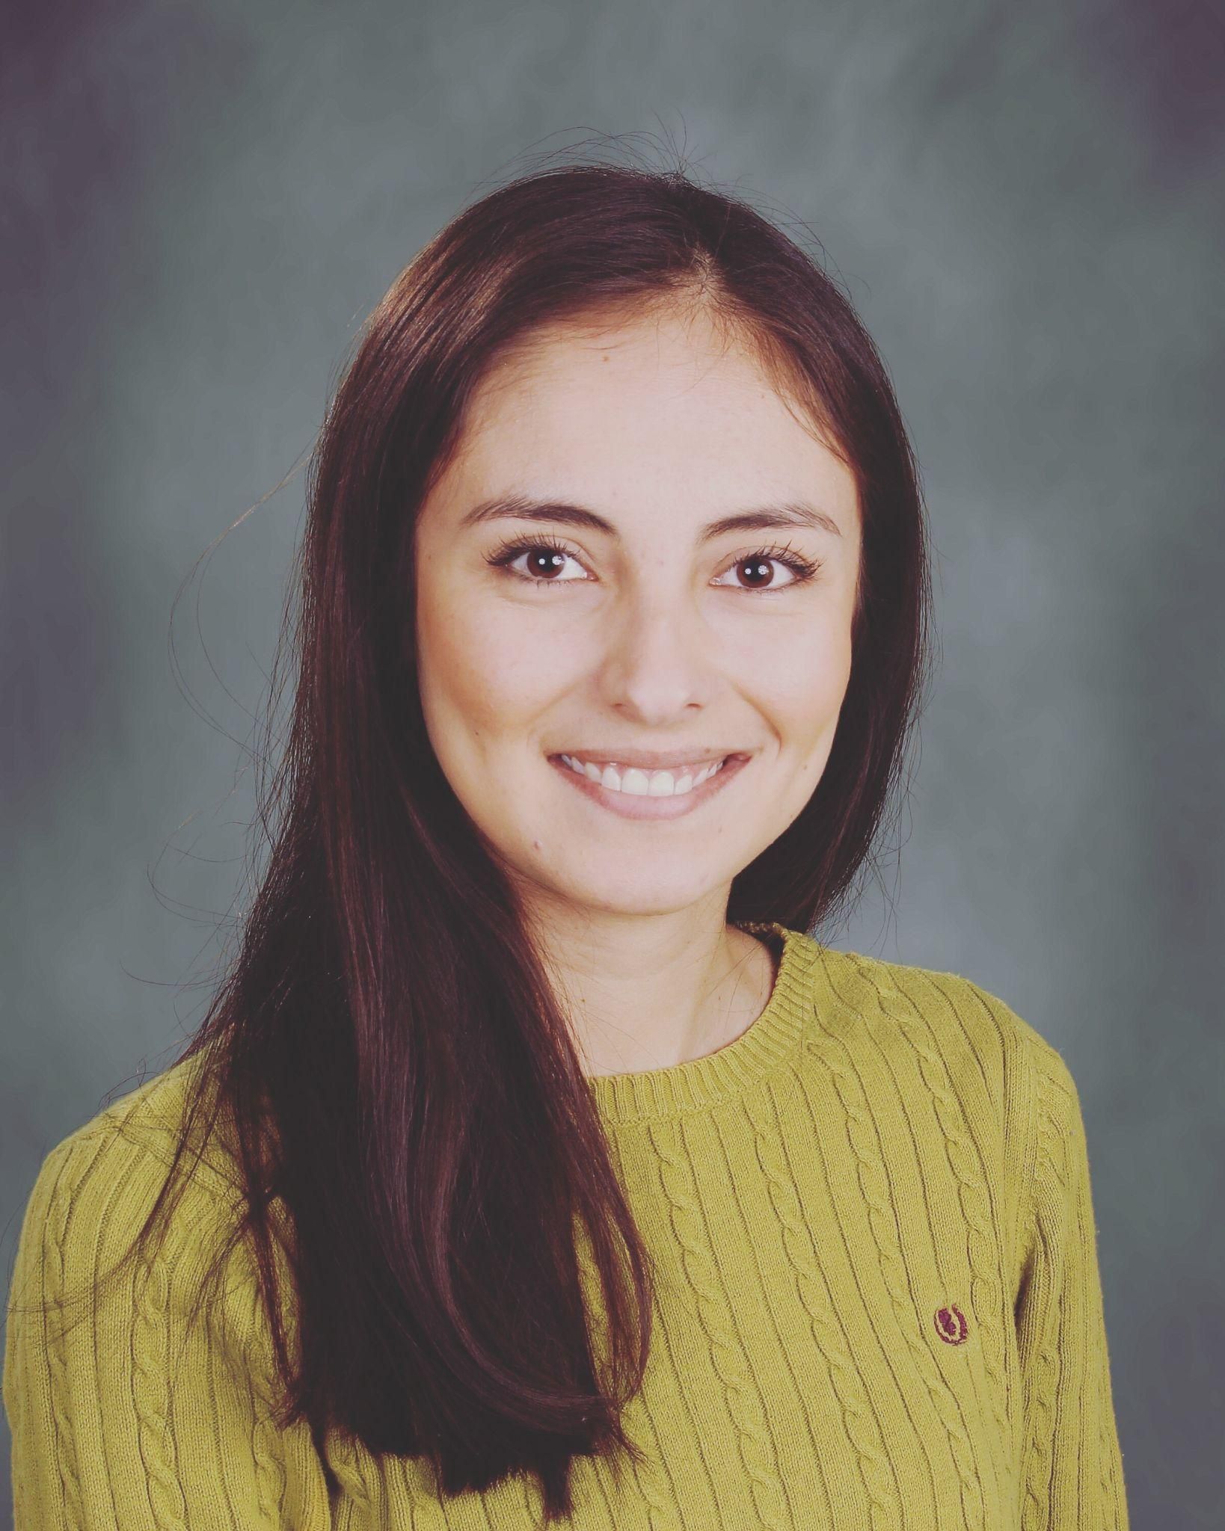
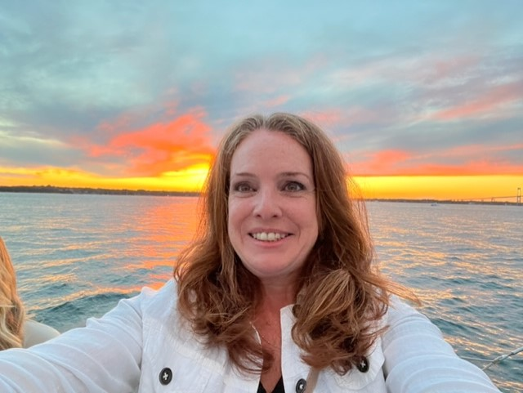
Support Staff
Ms. Wigger
ENL
awigger@schools.nyc.gov
Ms. Van Patten
ENL
evanpatten@schools.nyc.gov

Slide 16
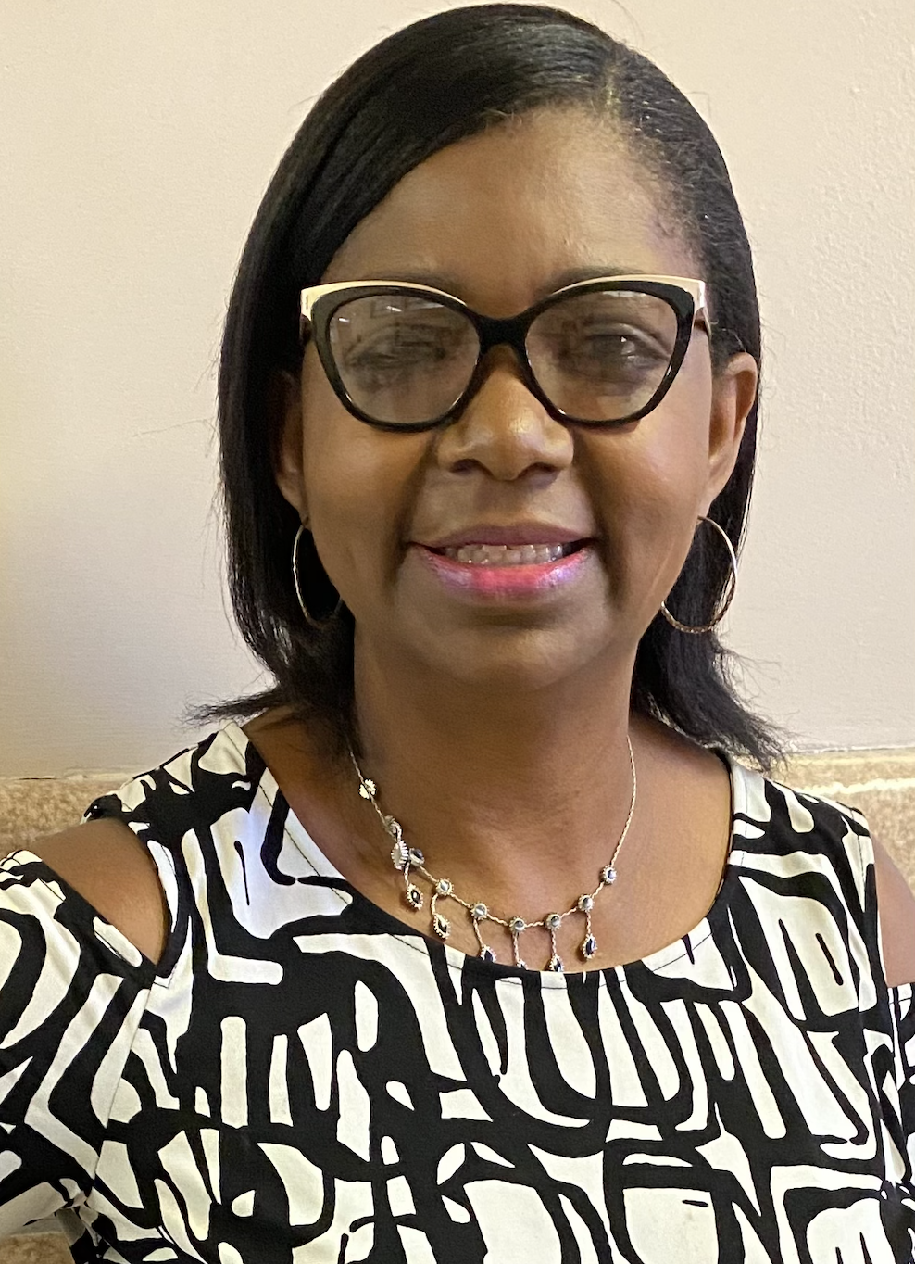
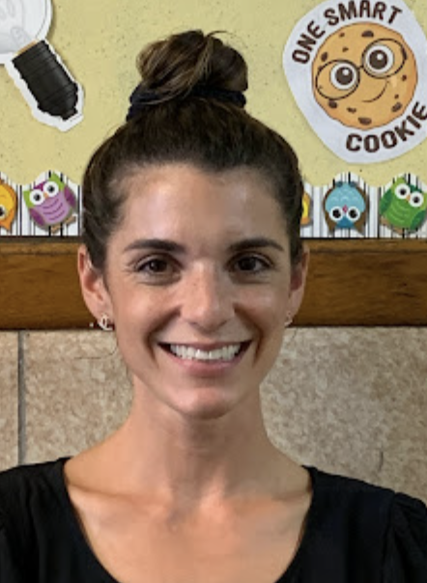
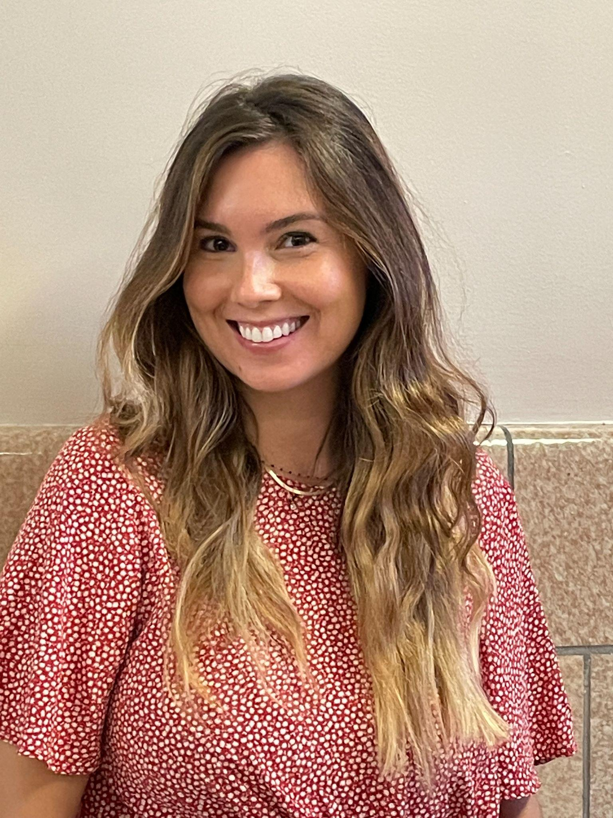
Support Staff
Ms. Streany
Speech
jstreany@schools.nyc.gov
Ms. Alagor
Physical Therapist
MAlagor@schools.nyc.gov
Ms. Boshnack
Hearing Specialist
aboshnack@schools.nyc.gov
Ms. Ianda
Occupational Therapist
jianda@schools.nyc.gov

Slide 17
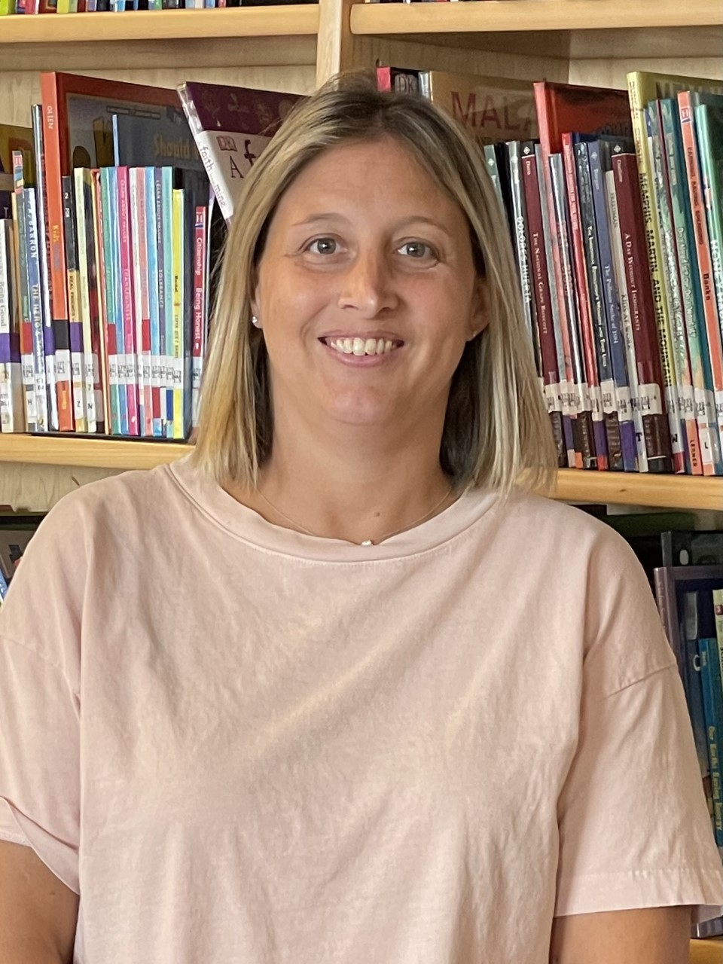
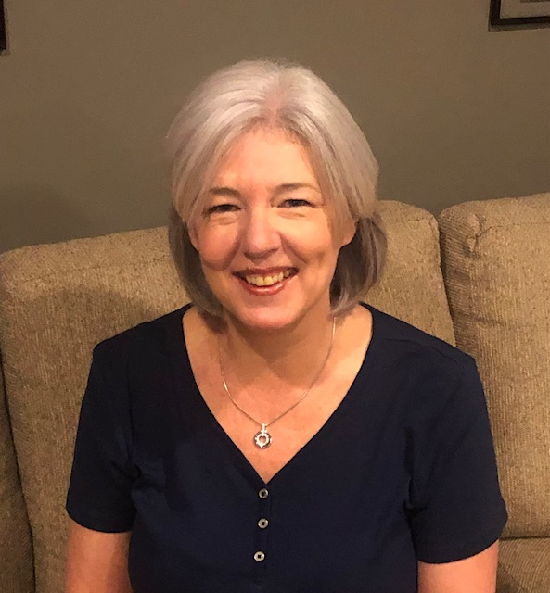
Support Staff
Ms. Anthony
Instructional Coach
santhony9@schools.nyc.gov
Ms. Milazzo
Instructional Coach
kmilazzo3@schools.nyc.gov

Slide 18
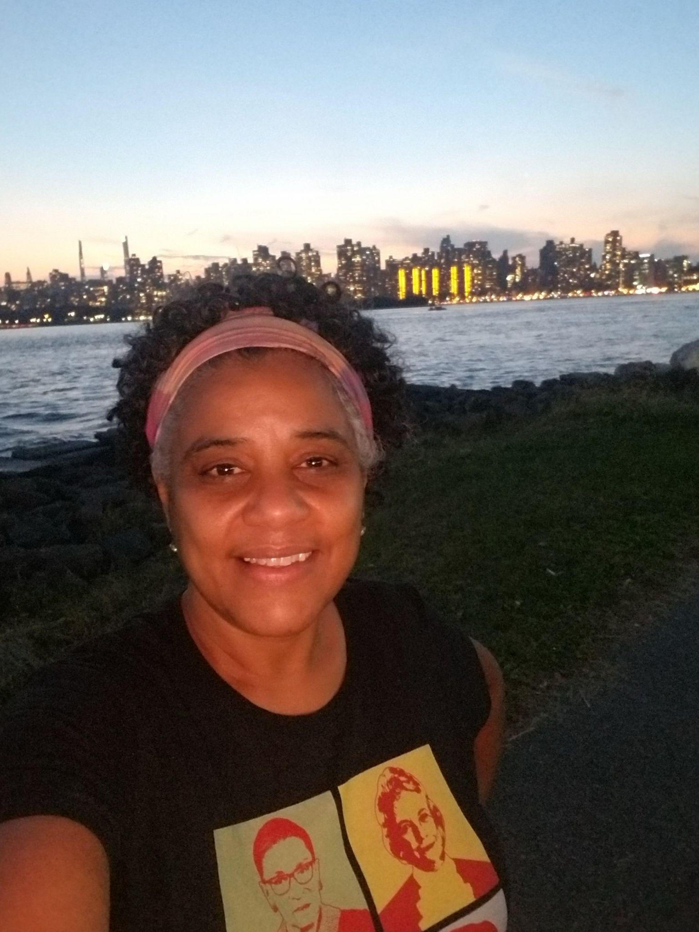
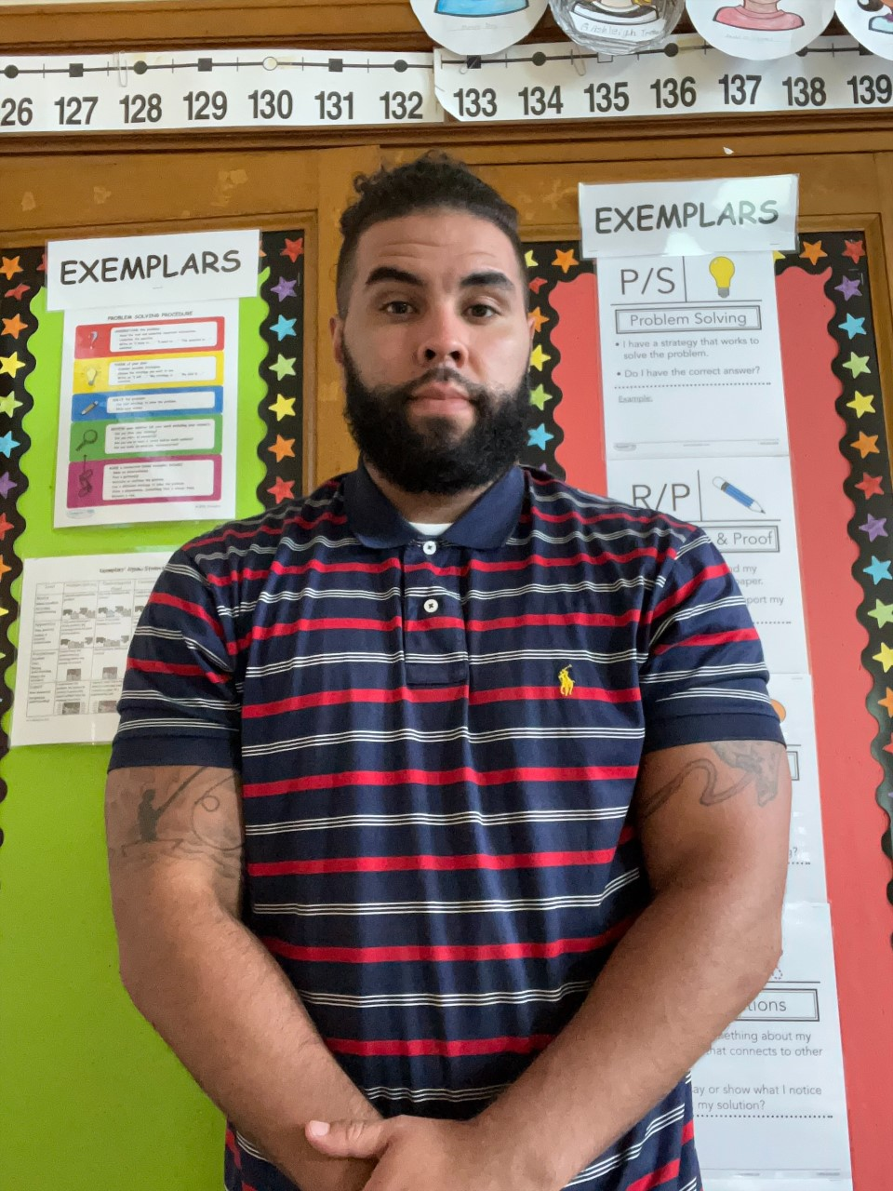
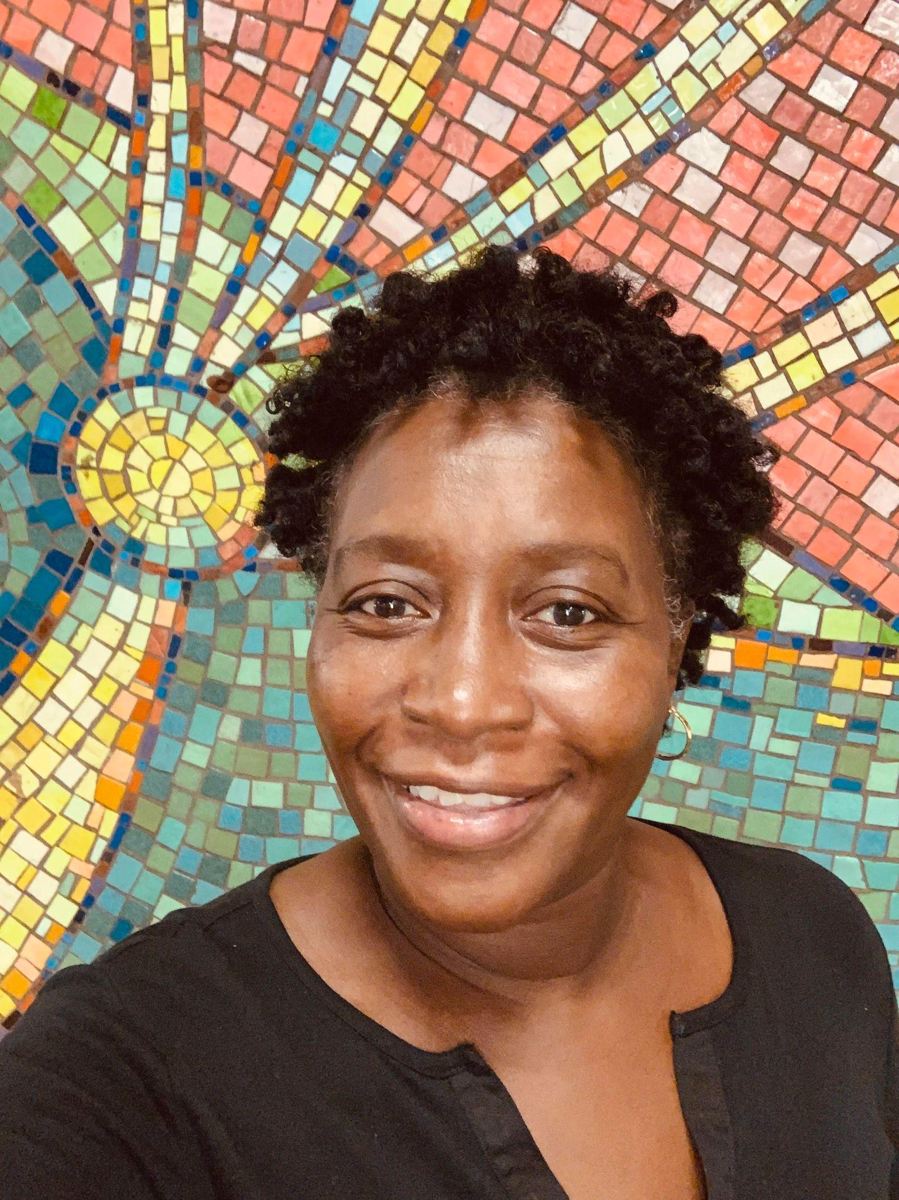
Paraprofessionals
Ms. Rolon
Mrolon@schools.nyc.gov
Mr. Perez
Lperez42@schools.nyc.gov
Ms. Guity
lguity5@schools.nyc.gov

Slide 19
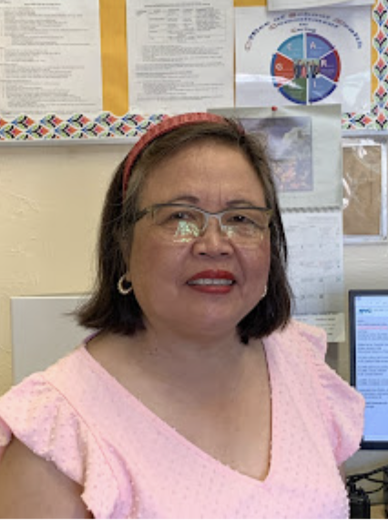
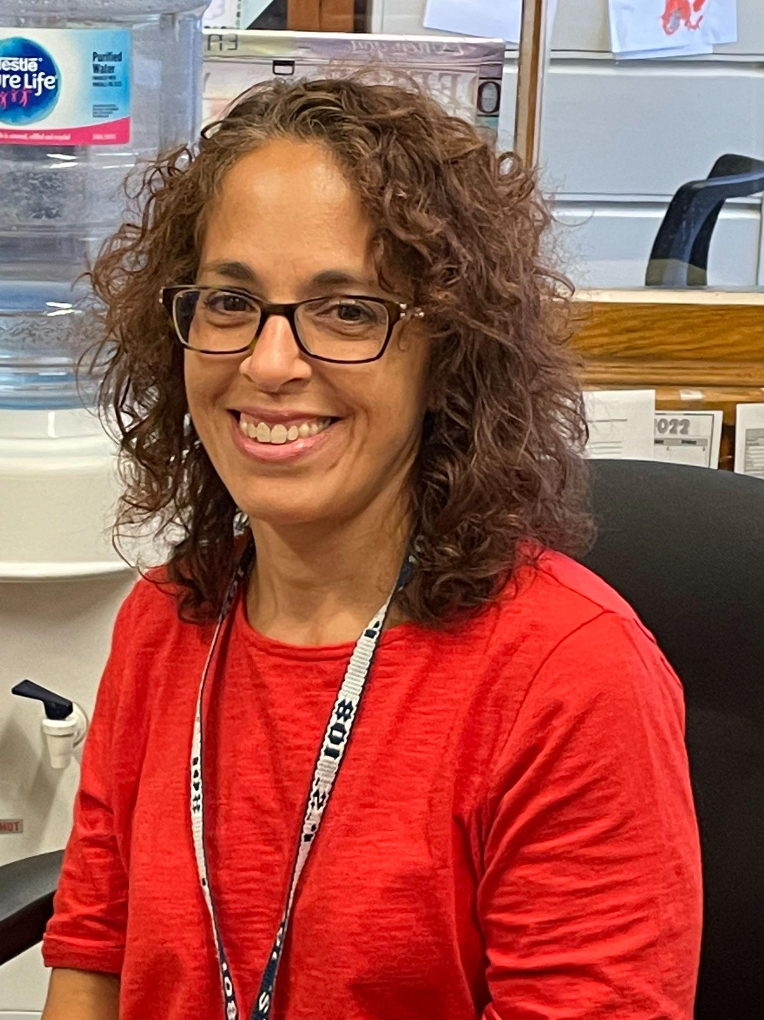
Medical
The school clinic is operated by a school nurse. Parents are called if their child has a fever or appears to be suffering from an illness or injury. To ensure prompt notification it is critical that all emergency forms are current.
Ms. Bernas
School Nurse
mbernas@health.nyc.gov
Ms. Greco
Health Intern
bgreco@schools.nyc.gov

Slide 20
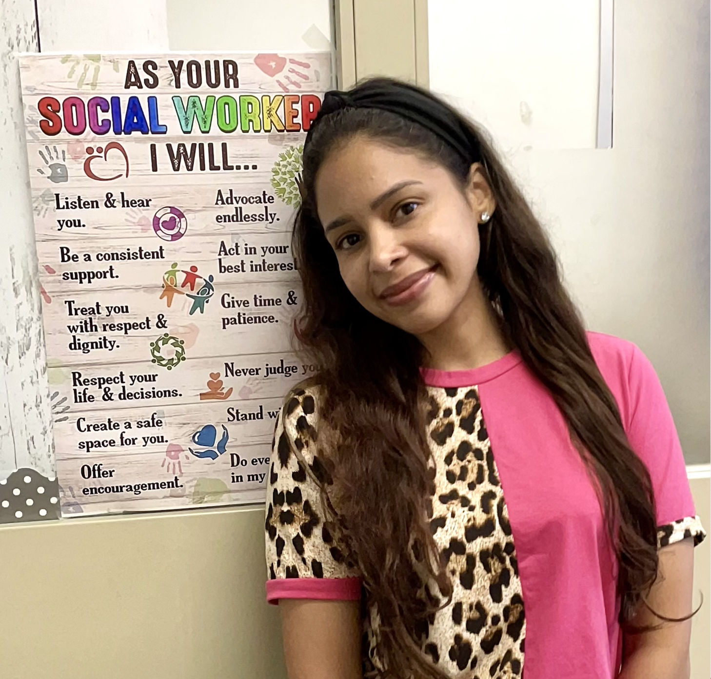



School Based Support Team (SBST)
Mr. Cotter
Psychologist
jcotter@schools.nyc.gov
Ms. Pereyra
Social Worker
jpereyra2@schools.nyc.gov
Ms. D’Agostino
Family Worker
FDAgostino@schools.nyc.gov
Ms. Brasero
Social Worker
abrasero@schools.nyc.gov

Slide 21


Guidance Counselor
Ms. Jiggetts
ljiggetts@schools.nyc.gov

Slide 22


Office Staff
Ms. Koutoulas
mkoutoulas@schools.nyc.gov
Ms. Maraia
gmaraia@schools.nyc.gov

Slide 23





School aides
Ms. Thieleke
gthieleke@schools.nyc.gov
Ms. Loretta
Aloretta@schools.nyc.gov
Ms. Granitto
rgranitto@schools.nyc.gov
Ms. Angell
tangell@schools.nyc.gov
Ms. Rizaj
lrizaj@schools.nyc.gov

Slide 24

Parent Coordinator
The Parent Coordinator is a staff position created by the Department of Education to help parents/guardians and their children.
Our Parent Coordinator, Giorgina Rodriguez is the designated person to assist parents and guardians with information about our school or the public school system.
The Parent Coordinator works to strengthen and improve communication between the school and families.
Ms. Rodriguez can assist families in communicating with P.S. 108 teachers and administrators. She can be contacted by phone (332) 216-5378.,
or by email: Grodriguez23@schools.nyc.gov
Ms. Rodriguez is available to meet or talk with you about any questions or concerns you may have, and she can facilitate communication with other staff members. She is also available to help with translations or
facilitate community resources.
Ms. Rodriguez
Grodriguez23@schools.nyc.gov

Slide 25

School Safety Agent
Visitor Policy
All visitors (age 18 and older) must show proof of at least one dose of the COVID-19 vaccination to enter a DOE building. Visitors do not include students attending school in a DOE building. No visitors will be allowed past security. Anyone picking up their child early will wait by security and the student will be escorted down to meet you. If you need to go to the main office you will need to sign in
Agent Ryell
School Safety Agent
Notes:
Need to update with doorbell info

Slide 26



Custodial Staff
Mr. Tierney
Custodial Engineer
mtierney2@schools.nyc.gov
Mr. Polgano
Mr. Perez
Mr. Delgado
Mr. Haughton

Slide 27




Kitchen Staff
Ms. Heeger
Dietician
vheeger@schools.nyc.gov
Ms. Richardson
Mr. Baker
Ms. Kulsum
Ms. Zabala

Slide 28

PTA
Tara McCrossan &
Vinny Marie Leone
Co-Presidents
Melissa Lootens
Treasurer
Sonia Marini
Recording Secretary
JodiAnn Beans
Corresponding Secretary

Slide 29
SLT
SLT Meetings Our school leadership team meets one time a month.
All schools are required by the State legislature to establish a School Leadership Team, which develops a Comprehensive Educational Plan (CEP) and that it is aligned with the school- based budget for the ensuing school year. The school-based budget provides the fiscal parameters within which the SLT will develop the goals and objectives to meet the needs of students and the school’s educational program.
The team is comprised of the principal, the PTA president, the United Federation of Teachers (UFT) chapter leader, elected teacher
representatives, and elected parent representatives. Parents’ membership on the School Leadership Team helps ensure that the parent voice is represented in important decisions that affect teaching and learning in our school.
Please contact this year’s team members if you would like the School Leadership Team to address a particular issue. School Leadership Team meetings are open to all parents/guardians of our school.
For School Leadership Team meeting dates, please contact the PTA office, Parent Coordinator, or School Leadership Team members listed under, Teachers.
SLT Members
Ms. Mustafa | Principal
Ms. Solano | AP – SLT Chair
Ms. Breitenbach | UFT Chapter Leader
Teresa Roksvold Megan Lanza Katie Milazzao | Teachers
Tara McCrossan Vinny Marie Leone | PTA
Lucia Giraldo | Title I
Sonia Marini TBD TBD | Parents

Slide 30
Mission &
Vision
Vision
Our vision is to provide a comprehensive, rigorous, exciting educational program with an emphasis on literacy and mathematics development that is aligned with NYS and NYC performance standards. Guided by the principles of learning, students are challenged to think critically. Inquiry, analysis, problem solving and decision-making are integral parts of an educational program that allows students to achieve individually and cooperatively. Our collaborative spirit seeks to nurture and support the whole child. Through academic and artistic endeavors students develop self-confidence, tolerance and independence while celebrating similarities and diversity. Educators and parents support efforts to increase student access to information with a growing emphasis on technology. P.S. 108 recognizes its responsibility to prepare students not only for the next level of education but also for the many challenges facing productive citizens of an ever-changing society.
Mission
P.S. 108’s mission is to empower our students with the social and academic skills needed to meet the high standards of excellence in order to succeed in a culturally diverse society.

Slide 31

Instructional Focus 2023-2024
IF we continue the shift toward student-led classrooms, validate student voice and experiences, and provide students the opportunity to participate in thought-provoking learning tasks where students take initiative in their learning THEN we will strengthen student engagement, resulting in increased achievement for all.

Slide 32


School Calendar 2023-2024
DOE Translated Calendars

Slide 33
Services Offered
We offer many services to best support all learners at our school. Some services include:
Service | Staff | Contact
Special Education / IEP Special Education/SETSS | Ms. Simonetti Ms. LoCascio | Msimonetti2@schools.nyc.gov rlocascio@schools.nyc.gov
English as a New Language/AIS | Ms. Wigger Ms. Van Patten | awigger@schools.nyc.gov evanpatten@schools.nyc.gov
School Nurse | Ms. Bernas | MBernas@health.nyc.gov
Parent Coordinator | Ms. Rodriguez | Grodriguez23@schools.nyc.gov
Guidance Counselor & Social Worker | Ms. Jiggetts Ms. Pereyra | ljiggetts@schools.nyc.gov jpereyra2@schools.nyc.gov

Slide 34

Attendance
Regular school attendance is essential for a student’s academic achievement and will be closely monitored. The NYC School Chancellor’s regulations require that each student achieve a minimum of 90% attendance every school year.
If your child must be absent from school, please use the
following guidelines:
• Please provide advance notice to the school if the absence is anticipated.
• Please send in a note after each absence explaining your child’s absence when he or she returns
to school.
• Please call the school office if an absence lasts for two or more days. (718) 863-9829
• If appropriate, please include a doctor’s note indicating the reason for an extended absence and
permission for the child to return to school.
• Please schedule appointments for your child before or after school
“Good Attendance is not a matter of complying with the rules, but a matter of providing children with more and better opportunities to learn.”
~ Attendance Works

Slide 35


Slide 36

Watch this:

Slide 37
Late Arrival
Please make sure to get your child to school on time. Punctuality is an essential part of your child’s development as a student.
Teachers begin instruction immediately and students who arrive late disrupt that instruction.
Students who arrive at school after 8:00 a.m. will be marked late.
Please be aware that late marks become a part of your child’s permanent record and are a component for promotional criteria.

Slide 38


Slide 39
Arrival
Dismissal
Students should arrive to school no later than 8:00am.
The school building will open for breakfast at 7:30am.
All students will enter the main entrance on Neill Avenue for morning arrival.
Parents are not allowed in the building during morning arrival.
To assist with traffic we kindly ask all families dropping off students by car to pull up along the curb and “stop-drop-and go”.
Dismissal is at 2:20pm
*Students in Pre-K – 2nd grade will be dismissed out of Exit 2 and walk around towards Herring Avenue. Parents are encouraged to spread out around the corner to ensure a safe dismissal.
*Students in Grade 3-5 will dismiss from Exit 1 and line up along the front gate on Neill Avenue.
Late Pick up
All students not picked up at 2:20pm will be brought to the main entrance and calls home will be made.

Slide 40
Early Pick-up
If you are picking up your child before regular dismissal time, please try to let your child’s teacher know in advance. You must follow the following procedure:
• Present identification at the security desk
• Sign your child out by school safety
• A staff member will call for your child and escort them down to you.
Please note the following:
• Students will not be released to anyone under the age of 18
• Students will not be released to anyone who has not been designated on the blue cards
• Students will not be released without a signature
We strongly discourage picking up students between 2:00 p.m. and 2:20 p.m. in an effort to avoid confusion during dismissal.

Slide 41

P.S. 108 students in every grade wear a uniform daily.
Navy Blue/ Light Blue Top
Navy Blue Pants / Skirt
Sneakers Recommended
Please note that flip flops and slides are never allowed in school.
Please use this link to order School Uniforms: www.SmoothUSA.com/PS108x
Student Dress Code

Slide 42


Slide 43
P.S. 108 follows the NYC DOE Behavior Policy
The New York City Department of Education (NYCDOE) is committed to ensuring that our schools are safe, secure, and orderly environments in which teaching and learning take place each day. A safe and supportive school depends upon the efforts of all members of the school community—teachers, students, administrators, parents, counselors, social workers, safety personnel, related service providers, cafeteria, custodial, and bus staff—to treat one another with mutual respect.
Behavior Policy
NYC DOE Behavior Policy

Slide 44

Panda Pride!

Slide 45

PBIS
Our school will continue to implement the evidence-based approach, Positive Behavioral Interventions and Supports (PBIS) for the upcoming school year. In our PBIS, the learners are awarded for excellent behaviors and for meeting the objectives set for them. One of the key components of PBIS is establishing school-wide expectations for behavior. These expectations will be taught to students and reinforced throughout the school day, and we believe this will help create a positive and safe learning environment for all students so that we all have a successful and exciting school year!

Slide 46


Slide 47

Notes:
Insert matrix

Slide 48


Slide 49
Cell Phone Policy
Cell phones, smart watches and any other communication devices may not be used while in the school building.
If you feel your child must have a cell phone, it must remain in their backpack, TURNED OFF while at school and during after school programs.
Texting and videotaping are not permitted anytime during the school day.
Students will be given a warning if found with their cellphones.
The 2nd incident will result in phone removal and parents must pick up the phone from school.

Slide 50
School Bus Safety
Students must:
• Get on the bus quietly
• Fasten seat belt immediately
• Remain in seat until the matron gives permission to leave the seat
• Keep arms and legs out of the aisle
• Get permission from bus personnel before opening a window
• Follow directions of bus personnel
• Act in an appropriate, responsible manner so that everyone can have a safe bus trip
Students must NOT:
• Talk to the driver while he/she is driving
• Leave your seat until told to do so by bus personnel
• Fight, throw objects in or out of the bus, annoy others, smoke, light matches, scream, yell, curse,
damage the bus, open the door, or do anything that is considered dangerous

Slide 51
Field Trips
School sponsored field trips are designed to complement the curriculum and are related to the Standards of Learning taught. A field trip permission form will be sent home for each trip and must be completed by the parent/guardian.
*Parent/guardian will be notified of each field trip.
*Some field trips may require a nominal fee for student participation.
*Parent/guardian may be required to escort a child on a field trip due to his/her behavior.

Slide 52
Birthday Celebrations
Celebrating a birthday is always an exciting experience for every child. While school is traditionally a place of learning, we also understand the importance of a child celebrating their special day with classmates.
You are always welcome to bring in a treat for your child's birthday. If you are interested in having a birthday party for your child in school, please notify your child’s teacher at least a week in advance so that there will be no conflict with other activities.
Cupcakes and juice boxes are preferred. WE ARE A NUT FREE SCHOOL. We ask that you please be mindful and read the labels and that you do not bring in anything with peanut traces.
If you are going to give out goodie bags please refrain from candy with nuts and any “toys” that can be dangerous to small children. Please be sure to provide enough “treats” for all the students in your child’s class (including napkins, plates, etc.). We also remind you that balloons are NOT permitted in school.
Birthday parties are held at the end of the day. Parents and siblings are NOT invited to attend any classroom birthday celebrations. All snacks and treats can be brought to the main office or sent to school with your child.

Slide 53
Lost and Found
Articles found in the building or on school grounds should be turned into the office. Articles not claimed by the end of each month will be discarded or be donated to charitable organizations. To assist in recovery of lost items, please ensure items have your child’s name written on them.

Slide 54
School Curriculum
K-2 Foundational Skills
Really Great Reading
Science
Amplify
ELA
EL Education
Math
Eureka
Social Studies
Passport

Slide 55

Online Curriculum Resources
Imagine Learning
Imagine Math
Great Minds
Eureka
(Teach Hub)
EL Education
(Teach Hub)
Prodigy Math
(Teach Hub)
Get Epic!
Zearn Math
(Teach Hub)
Notes:
Link sites

Slide 56


GRADING POLICY

Slide 57
Parent
Teacher Conferences
Parent/Teacher conferences are held four times this year during the months of November and March. Parents will be able to access Report cards on PTC days on your NYCSA account. All conferences will be held virtually. If you have questions or concerns during the year you may schedule an appointment with your child’s teacher.
September 14th- Back to School Night
November 2nd- Fall Conferences
March 7th- Spring Conferences
May 9th - End of the Year Celebration

Slide 58
Required Forms
It is essential that each year parents complete the following documents:
• Blue Emergency Cards
• Application for School Breakfast/Lunch
• Signed consent to photograph and videotape students for educational purposes
• Internet Use permission form
• Medical forms with a listing of all immunization
EMERGENCY CARDS
We ask that you please take the time to update emergency contact information on an as-needed
basis. In the event of a medical or national emergency or school closing, we must be able to reach
you or a family member. Please be sure to notify the school of any changes in address, phone
number or emergency contact.

Slide 59
Enrichment Programs and Student Opportunities
ENL Academy
Art & Music
Inside Broadway
English as a New Language students in kindergarten through 5th grade are invited to participate in various language development activities on Saturdays.
Students are provided an opportunity to participate in these enrichment
programs on a weekly basis.
Select students in 3rd & 4th grade are invited to participate in an afterschool arts
program twice (2x) per week.
ELA/Math
After School
Make Your Moment
Mastery Coding
Students in grades 3-5 are invited to attend the afterschool program to reinforce skills and strategies for the state tests.
Select students in 5th grade are invited to participate in a 4 session mentoring program with former NY Ranger Stephane Matteau
We have partnered with Mastery Coding to offer an afterschool program for our 3rd - 5th grade students. The focus of the program will be to learn about the science, math and technology behind the popular game MINECRAFT.

Slide 60
Enrichment Programs and Student Opportunities
Bricks 4 Kids
Road Racers Running
Science Club
Chess Club
Math Olympiads
NY Public Library
Through partnerships with local libraries, students have access to
educational programs and resources – including story time, parent workshops, school visits, and library visits.

Slide 61
Helpful Resources
If your child is having difficulty with schoolwork, you can…
Contact your child’s teacher by:
  Email
  Phone @ 718-863-9829
  School APP
Meet with your child’s teacher by appointment.
If your child is having issues with other students, you can…
Notify your child’s teacher or guidance counselor
Ms. Jiggetts (x2192) ljiggetts@schools.nyc.gov
Ms. Pereyra (x2191)
jpereyra2@schools.nyc.gov

Slide 62
Helpful Resources
If your child is having a family issue that is interfering with their schoolwork, you can…
Notify your child’s teacher or guidance counselor
Ms. Jiggetts (x2192) ljiggetts@schools.nyc.gov
Ms. Pereyra (x2191) jpereyra2@schools.nyc.gov
Contact our Parent Coordinator Ms. Rodriguez (x1300) grodriguez23@schools.nyc.gov

Slide 63

Ways to stay informed with what’s going on at P.S. 108
· Visit our School Website https://www.publicschool108.net/
· Monthly calendar sent home
· Check your child’s folder
· Join P.S. 108 PTA
· Attend PTA meetings
· Read posted flyers around school building
· Call the main office and ask questions (718) 863-9829
· Contact our Parent Coordinator Ms. Rodriguez (x1300) or by email at grodriguez23@schools.nyc.gov
*JOIN OUR SCHOOL APP!
Click Here for the School App

Slide 64


Slide 65


Slide 66


Slide 67


Slide 68


Slide 69






PTA
Parent-Teacher Association
Jodi Ann,
Correspondence Secretary
Tara McCrossan
Co-President
Vinnie Marie Leone
Co-President
Melissa Lootens
Treasurer
Sonia Marini
Recording Secretary
Erin Edwards
Sergeant At Arms
Last year, we were able to provide 108 students with a Rye Playland trip, Blue Day, MineCraft coding, Bricks 4 Kids, Paint Night, Sweetheart Dance and many more. If you like these, please donate to the PTA, $10 per family, and support our fundraisers so we are able to continue these wonderful opportunities for all students!

Slide 70


Slide 71


